Slide 1
*Insert Exercise Name Here*
Notes:
NOTE TO FACILITATORS
The following slides provide you with a self-paced walk through of the agenda for the day, supported with speaker notes.
There are some slides that direct you to switch to other presentations. Make sure you have these other presentations preloaded on your computer for a seamless transition.
Notes are in standard format. Facilitator actions are in bold italics.
It’s a good idea to print out a “notes” version of the slide deck for your reference.

Slide 2
Welcome to Country
Notes:
ACTION: Invite a local Indigenous person to attend the exercise to conduct the Welcome to Country.
Alternatively, if you are conducting an Acknowledgement of Country, please amend slide text to reflect this.

Slide 3
Housekeeping

Slide 4
Objectives
Explore recovery considerations across the short, medium and longer term
Strengthen collaboration and coordination in recovery
Practice evidence informed approaches to recovery strategies and activities
Explore the roles and responsibilities of government, non-government and local community stakeholders in recovery
Identify areas for further development to inform recovery planning
Notes:
ACTION: Walk through the objectives for the day

Slide 5
Who is in the Room?
Notes:
Introductory activities – 15mins
ACTION: Introduce each table group by the recovery subcommittee you have allocated for the table.
Table group introductions
ACTION: Ask people to introduce themselves around their table and briefly talk about the role/s they have had in recovery.
Whole group activity - Who is in the Room?
It’s helpful for everyone in the room to be aware of the wide range of participants that are attending the exercise day.
ACTION: Ask people to raise their hands when they are part of the following groups and to call out which organisations they are from:
Council staff
State government agencies
Local community organisations
Community representatives
Non-government organisations
Business and industry groups
Any other groups or individuals

Slide 6
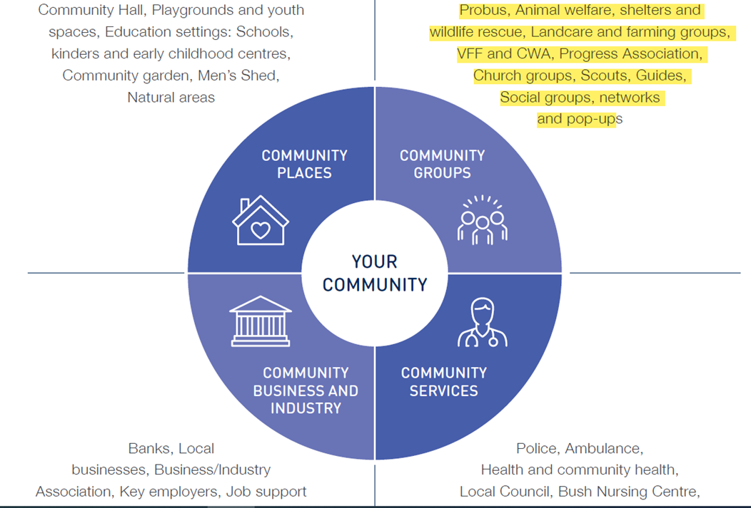
Understanding Who the Community is - Before the Disaster
National Principles for Disaster Recovery:
Understanding the context
Successful recovery is based on an understanding of community context, with each community having its own history, values and dynamics.
Stakeholder Guide for Community Organisations (VCOSS 2022)
Diagram 5 – Community Profile (P15)
Notes:
Understanding who the community is - before the disaster
All emergency management processes should begin with understanding of the strengths and values of the community. This is especially true in recovery.
Understanding who makes up your community – social demographics, different community groups, what your community’s strengths are and what is most valued, before a disaster hits – will help inform recovery priorities and strategies; and what can be done to try and protect or restore these things with greater priority. Council holds much of this information in community plans
Community profiles are a useful way to describe and share information about the community. This exercise is particularly important if you have people on your recovery committee who are not from, or familiar with the local community
Councils usually hold much of this information, however if not readily available, The AIDR Community Recovery Handbook encourages recovery managers to take the time necessary to develop a basic community profile as an invaluable tool to support sustainable recovery outcomes and community resilience. (Community Recovery, AIDR 2018, p49)
There are many good examples of community profiles, check out what is available in your state or territory.
A couple of good examples include:
Community Engagement for Disaster Resilience, 2020, Australian Institute for Disaster Resilience: aidr_handbookcollection_communityengagementfordisasterresilience_2020.pdf
Stakeholder Guide for Community Organisations, 2022, Victorian Council of Social Services (VCOSS): Whos-who-and-what-do-they-do-recovering-from-emergencies-and-disasters.pdf (vcoss.org.au)
Disaster Recovery Guide for Councils, 2017, South Australia Local Government Organisation: 2017_LGA_Disaster-Recovery-Plan-Document.pdf

Slide 7
Understanding the history of disasters in your area
Experiences of previous disasters will impact on how people will respond to and recover from the current disaster
Consecutive and concurrent disasters have compounding impacts for individuals and communities and will affect recovery from the next disaster event.
The more frequently disasters occur, the less time there is to recover between disasters:
Recovery will be slower
Risk of mental and physical health challenges will be higher
Notes:
Understanding the history of disasters in your area is important for setting community context.
Previous disasters are part of the history of the community. You need to be aware of the disasters that have happened in the past as they will impact on how people respond to and think about the current disaster, and impact on how they will recover.
ACTION: Provide an overview of disasters in your community – has there been frequent disasters over recent years or has it been some time since the community has experienced a disaster? Is there one (or more) events that everyone remembers as really significant in your community?
Consecutive and concurrent disasters have compounding impacts for individuals and communities and will affect recovery from the next disaster event. The more frequently disasters occur, the less time there is to recover between disasters.
Compounding disasters slow recovery activities down.
For example, people who have experienced multiple flood events are faced with multiple clean ups. This can be very challenging, emotionally, physically and financially. There is a greater risk of mental and physical health challenges – and this need to be factored into your recovery planning
Alternatively, where there has not been a disaster event in your area for some time, community preparedness and resilience may be lower and local recovery stakeholders less practiced in recovery.

Slide 8
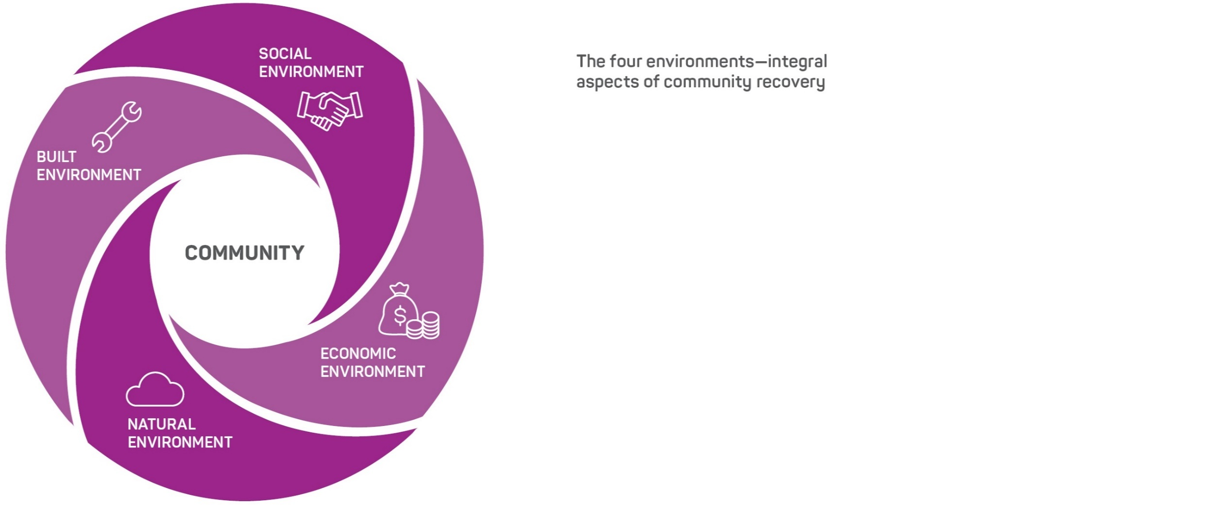
Recovery Environments
In [Jurisdiction] recovery environments align with the subcommittees or task groups
Xx
Xx
Xx
xx
Notes:
The range of community impacts of disasters can be described across the social, built, economic and natural environments. This Figure shows how all four environments constitute community.
The four environments are separated for the purpose of functional responsibilities within recovery, however, in terms of how communities operate the four environments are intrinsically linked. When working with communities in recovery, each environment should be considered and coordinated with all others in a systems approach that recognises their interconnection (Community Recovery, AIDR 2018, p54)
While jurisdictions may vary in the way they name recovery environments/domains and how they allocate functions into different task groups or sub-committees the foundations of the four environments, with community at the centre, remains the same.
ACTION: INSERT THE NAMES OF RECOVERY GROUPS/LINES/ SUBCOMMITTEES IN YOUR JURISDICTION ONTO THE SLIDE

Slide 9
State/Territory Recovery Arrangements
Notes:
SLIDE PLACE HOLDER
ACTION: Switch to your State/Territory Recovery Arrangements Slide Deck
This presentation provides an overview of:
your state recovery arrangements and governance structures
the history and experience of disasters and community recovery in your region/local area and the main recovery challenges faced.

Slide 10
Recovery Exercise Scenario
EXERCISE – NOT A FORECAST
The information on these slides is provided to illustrate the scenario and should not be used for decision-making. Photos and satellite views use historical information.
Notes:
SLIDE PLACE HOLDER
ACTION: Switch to your Exercise Scenario Slide Deck

Slide 11
Fundamentals of Community Recovery
Part A
Notes:
SLIDE PLACE HOLDER
ACTION: Switch to Fundamentals of Community Recovery Slide Deck
Note: the Fundamentals of Community Recovery can be run as a single session over an hour, or split into two components.

Slide 12
Notes:
Morning Tea

Slide 13
Fundamentals of Community Recovery
Part B
Notes:
SLIDE PLACE HOLDER
ACTION: Switch to Fundamentals of Community Recovery Slide Deck

Slide 14
Recovery Considerations 3 weeks – 3 months
Notes:
SLIDE PLACE HOLDER
ACTION: Switch to Recovery Considerations 3 weeks – 3 months Slide Deck
Introduction
This session is the first of three sessions run throughout the day that will focus on recovery considerations over time. Reporting back on table discussions will be held over until the whole group plenary after the third session (after Afternoon Tea).
3 weeks – 3 months
This presentation should take approximately 15 minutes to deliver
Breakout table group discussions 15 mins

Slide 15
Elective Module
Notes:
SLIDE PLACE HOLDER
ACTION: Switch to module that you have selected.
Available modules:
Working with Indigenous Communities in Recovery
Coordinating Recovery for People with Disability
Foundations of Economic Recovery

Slide 16
Notes:
Lunch

Slide 17
Recovery Considerations 6 to 12 months
Notes:
SLIDE PLACE HOLDER
ACTION: Switch to Recovery Considerations 6-12 months
This is the second session focusing on disaster impacts and community consequences, exploring recovery strategies over the time period 6-12 months.
6-12 months
This presentation should take approximately 15 minutes to deliver

Slide 18
6 Takeaways on Recovery After Disaster
Insights from Mallacoota on community-led recovery
Notes:
Action: You need to be in ‘slide show’ mode to activate the link
Video: 3:44 https://www.youtube.com/watch?v=DqfcENpYwvA
Two years into Mallacoota's recovery after the Black Summer fires, what advice do they have for other communities who might be facing or will face these sorts of challenges in the future?
This video shares a community’s perspective on recovery.
ACTION: As participants are watching the video ask them to think about what insights resonate with them most?
Whole group reflection – 6 mins
ACTION: Ask people to volunteer their responses back to the group
ACTION: As each person calls a response, invite others to raise their hands if they had the same/similar reflection
ABC People's Republic of Mallacoota - https://knowledge.aidr.org.au/resources/peoples-republic-of-mallacoota/
Insights from Mallacoota on community-led recovery - https://youtu.be/DqfcENpYwvA - Video length 3:44
The series was broadcast from April 2022 - May 2022. It is available to watch on ABC TV + iview.
The documentary series provides insight into the aftermath of the December 2019 Black Summer bushfires in Mallacoota, Victoria. The series platforms the stories of community members and the town's journey to forming and electing a community-led recovery committee: the Mallacoota and District Recovery Association (MADRA).

Slide 19
Recovery Considerations 12 months and beyond
Notes:
SLIDE PLACE HOLDER
ACTION: Switch to Recovery Considerations 12 months and beyond
This is the third and last session focusing on disaster impacts and community consequences, exploring recovery strategies over the time period 12 months and beyond.
12 months and beyond
This presentation should take approximately 15 minutes to deliver.

Slide 20
Notes:
Afternoon Tea

Slide 21
Plenary report: Recovery considerations over time
What was a key recovery consideration for each time period and what were your priority actions?
What issues have you identified that would benefit from further planning for inclusion in recovery plans and strategies?
Notes:
ACTION: Each table group to report back for up to five minutes.
Remind participants that the recorded outcomes from the three Recovery Considerations sessions will be provided to the representatives from their emergency management committee and council to inform ongoing recovery planning.
Encourage participants to take photos of their discussion templates for their own records.

Slide 22
Where to from here? Suggested next steps
Plan for and confirm membership of your Recovery Committee and respective subcommittees annually, so that it can be stood up quickly after a disaster.
Conduct annual pre-season briefings with community organisations and provide information about local emergency and recovery arrangements. Plan with community organisations how they can be involved and contribute as valued partners in recovery.
Conduct a community recovery exercise, including all community organisations that may have a role in local recovery arrangements.
Include a recovery exercise day as a standard component in emergency management exercise programs and whenever an emergency exercise is run.
Notes:
In some states and territories, regional/local emergency management arrangements include a standing Recovery Committee that meets regularly throughout the year, however this is not consistent across Australia.
Planning for and confirming Recovery Committee membership is a good idea in areas where a permanent Recovery Committee is not part of emergency management governance arrangements and structure.
‘Community organisation’ is a broad term that refers to whole of community, including business, private sector, environmental organisations and volunteer groups.

Slide 23
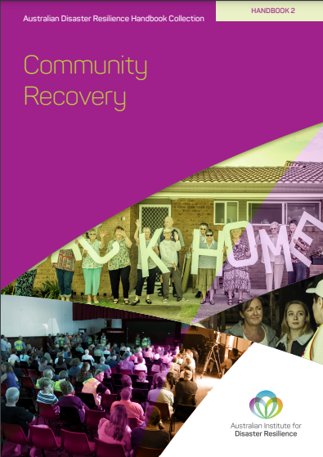
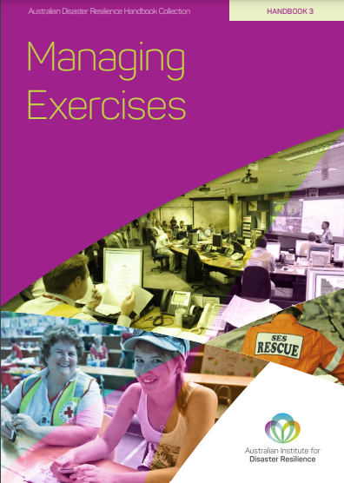
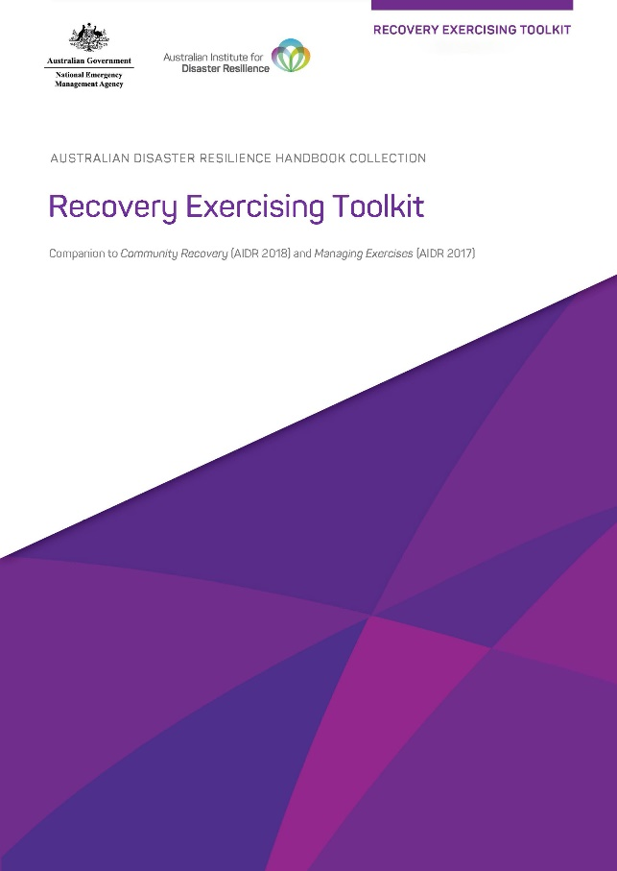
Recovery Exercising Toolkit
The Recovery Exercising Toolkit is a companion to the Managing Exercises Handbook and the Community Recovery Handbook
The Toolkit provides guidance and resources for the design and development of a recovery exercise and includes a range of modules:
Core modules
Fundamentals of Community Recovery
Recovery Considerations of Time
Elective Modules
Coordinating Recovery Support for People with Disability
Working with Indigenous Communities in Recovery
Foundations of Economic Recovery
Notes:
All the Module Overviews and Slide Decks from today’s exercise are available in the Recovery Exercising Toolkit which can be found on the AIDR Knowledge Hub: https://knowledge.aidr.org.au/resources/recovery-exercising-toolkit/
Encourage participants to visit the Toolkit, explore its resources and consider ways they could use the resources to build recovery capability in their committees and agencies.

Slide 24
Participant Feedback
Notes:
Q&A session: Opportunity for questions/reflections on the day throughout day.
ACTION: Distribute the Feedback Form and instruct participants to complete the feedback form now and leave it in the centre of the table. This is the most effective way of getting the most returns on the Feedback Form.

Slide 25
Close

