Slide 1
Foundations of Economic Recovery
Notes:
NOTE TO FACILITATORS
The following slides provide you with a self paced walk through of the module, supported with speakers notes.
Use your local knowledge and examples to make content relevant to participants, and add to or delete from this slide deck as needed.
The package takes approximately 60 minutes to run, allow up to 25 mins for the presentation and 30mins for the group discussion activity
Notes are in standard format. Facilitator actions are in bold italics.
It’s a good idea to print out a notes version of the slide deck for your reference.

Slide 2
Objectives
Increased understanding of:
Economic recovery concepts and principles
Economic impacts on individual
businesses and primary producers
Economic impacts on
a regional economy
The importance of the region's economic recovery to support community recovery,
and future resilience
Translating this understanding of economic recovery into action
Notes:
A vibrant local economy is a vital and normal part of a sustainable community, so in an emergency, economic recovery is critical to the whole-of-community recovery process. (Community Recovery Handbook, AIDR, pg 102)
This objectives of this session are to provide a foundational understanding of:
economic recovery concepts and principles
the economic impacts of disasters on individual businesses and primary producers
the economic impacts of disasters on business supply and value chains across regions and sectors
the importance of the regions economic recovery to support community recovery, and future resilience and sustainability
translating this into action.

Slide 3
Overview of business, industry and primary production in XXX area / region
Numbers of small businesses
Business districts
Main industries
Primary Production, livestock, crops - harvest times
Tourism attractions and businesses
Annual festivals, key dates for events
Chambers of commerce and peak industry groups in your area/region
Notes:
This slide provides an opportunity for you to set your local context and provide an overview of business, induction in your area/region

Slide 4
Everyone in the community is affected when a disaster hits, even if their home, property or business was not directly impacted.
Notes:
Regardless of the disaster, where it happens and who is directly impacted - a disaster impacts on the whole community.
A local economy is complex and everyone within a community forms some part of it. All types of businesses (primary production, town based small business or big industry) form part of a local economy.
Recovery strategies need to consider and be inclusive of the whole community and how it operates.

Slide 5

Supporting Businesses in Recovery
Ross Leggett
CEO Southern Queensland Rural and Small Business Financial Counselling Service
Renae Hanvin
Director, Resilient Ready
Notes:
ACTION: You need to be in ‘slide show’ view to activate the link
Video length - 5:26 minutes
https://www.youtube.com/watch?v=bbZYklMNLUA
In this video, business advisors share their expertise about the challenges small businesses and primary producers face after a disaster, the best ways to support them in recovery and what they can do to be better prepared and more resilient in future disasters.
Ross Leggett is the Chief Executive Officer at the Rural and Small Business Financial Counselling Service in Southern Queensland. The Service partners with Government, private enterprise and charitable institutions to deliver services, programs and events that support rural and small businesses and their communities in Queensland.
Renae Hanvin is the founder and director of Resilient Ready, a certified social enterprise driving a new ecosystem in business and community risk reduction and resilience. Her focus is to strengthen community networks and global wellbeing in this new era of disasters.

Slide 6
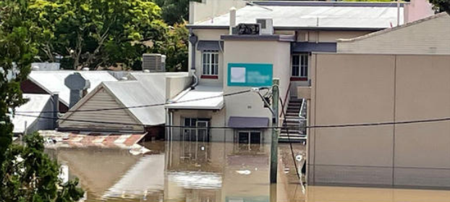
Economic recovery is complex
The economic recovery environment is one of the most complex aspects of recovery.
Economic impacts may affect:
  Individual businesses
  Business or industry sectors
  Locations and regions
  Employment types (casual or temporary employees)
  Supply chains and value chains.
HINT – Re-establishing business is vital to community functioning and recovery.
Notes:
Broadly, the range of economic effects and consequences on an affected community varies greatly and depends on the nature and duration of the event and the community itself.
It is important to recognise that communities are diverse. In some cases, affected communities recover and prosper; in others, the adverse economic impact compounds other social and economic challenges with an effect that spreads throughout the community.
This is one of the reasons why the economic recovery environment is one of the most complex aspects of recovery.
Even if a business isn’t directly impacted – it will be impacted in some way by the consequences of a disaster event. Economic impacts may affect:
individual businesses
business or industry sectors
locations and regions
employment types (casual or temporary employees)
supply chains and value chains
seasonal variations.

Slide 7
Multiple disasters – compounding impacts
Can no longer look at the impacts of one event in isolation
  drought … flood … bushfire … COVID19…
At the best of times, it is hard to run a small business or be a primary producer
Financial and business continuity planning isn’t enough to mitigate the effects of compounding disaster events.
The effects of multiple compounding events will require significant support and understanding.
Notes:
We can no longer look at the impacts of one event in isolation: Drought … flood … bushfire … Covid…
Communities and businesses face the compounding effects of multiple events.
ACTION: Question for whole group discussion: What are some of the anticipated economic impacts and consequences from a disaster event in this region?
Business owners (both small and Agriculture) are now in a prolonged and heightened state of anxiety because of the compounding affects – their recovery (both emotionally and reconstruction) people may not be over the one event when the next event is looming.
Recovery practitioners need to take into account this larger ongoing and evolving context – one off plans or scenarios will no longer be enough.
Its hard running a small business or being a primary producer and the new environment we find ourselves in, with compounding events affecting multiple communities only make this so much harder.
Even the most financially aware with good risk management and business continuity will be affected by compounding disaster events.
A business may withstand a single disaster event but very few can withstand multiple compounding events without significant support and understanding.

Slide 8
Direct and indirect economic impacts
Direct impacts are tangible (e.g. physical destruction) and can normally have a dollar value easily assigned
Indirect impacts are consequences from an event (e.g. power disruption, customer downturn)
Intangible impacts don’t necessarily have a dollar value but can be lasting effects on the livelihoods within community (e.g. loss of future contracts).
HINT – direct and indirect impacts have different consequences at multiple levels within a local economy…
your recovery planning and preparedness activities should take this into account.
Notes:
Direct impacts of disasters
Direct impacts result from the physical destruction or damage to buildings, infrastructure, vehicles and crops etc from direct contact with the disaster event.
Indirect impacts of disasters
Indirect impacts are incurred as a consequence of an event but are not due to the direct impact.
Indirect impacts of disasters can be very damaging on businesses and tourism.
Some indirect impacts may be positive with increase in construction industry for reconstruction of infrastructure. However, many such as the flow on business impacts and broader economic impacts that can occur from disruption to business operations (such as; loss of trade ; and continued reduction of business and customers particularly, especially in tourism-based businesses).
Sometimes, even though major tourism centres are not directly affected by a disaster, compounding factors can lead to a dramatic reduction in tourist visitors for long periods.

Slide 9
Clean up, re-stocking and opening the doors isn’t the end…
…it’s the beginning…
…economic recovery is long, private and occurs behind closed doors.
Notes:
A disaster happens to the whole community.
Recovery strategies including economic recovery need to consider, and be inclusive of, the whole community.
These strategies need to be across short, medium and long term recovery.
Like all aspects of recovery, economic recovery is not a quick fix. It is a long and complex journey.

Slide 10
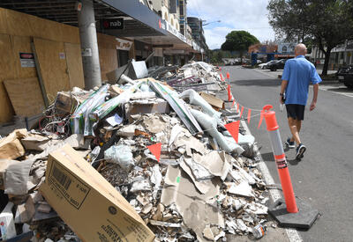
Disaster impacts = debt for businesses
Shorter term driven by loss:
Clean up and repair of home and business premises
Psycho-social impacts – both business and personal relationships
Tourism and/or customer downturn
Access to trades and building materials
Workforce and employees
Disruption to supply chains
Source: AAP
HINT – How do we support both business and business owners?
Notes:
Disaster impacts = debt for businesses
What are we looking at here: Short term - the event has passed, the immediate clean up has happened, but businesses are closed.
There is a loss of income perhaps driven by:
Loss or damage to business premises and equipment
Loss of tourism and/or customer downturn and foot traffic
Loss of access to trades and building materials
Loss of workforce and employees similarly impacted
Loss or disruption to supply chains and value chains
These impacts can often be compounding in effect – this highlights the need for multiple economic strategies to be developed and implemented to address the range of challenges.

Slide 11
Disaster impacts = debt for businesses
Longer term continued economic hardship due to ongoing losses:
Ongoing customer downturn
Damage to productive land and crops
Loss of cash flow – unable to resume income-generating activities
Loss of confidence – e.g. failure to meet contracts may lead to loss of future contracts
Bloodlines or genetic traits
Incurred disaster debt will take between 5 to 20 years to pay off.
Dual impacts of disasters
Rising debt level and
decrease in equity and cash flow.
Notes:
Some things like tourism activities or customer downturn and damage to productive land and crops may be immediately felt following a disaster and continue to be felt for a long time to come.
Sources of long term impact may include:
Loss of cash flow, making it impossible to resume income-generating activities due to customer downturn or, from an agribusiness perspective, the loss or damaged productive land
Loss of confidence driven by failure to met contracts which may lead to loss of future contracts
Loss of bloodlines or genetic traits
This results in the compounding affect of increased debt to repair and restock and reduced cash flow and equity as a result of the event.

Slide 12
Local economic impacts are many and layered
Early understanding is critical to inform multiple interventions.
Early interventions are critical to reduce long term affects.
Notes:
A disaster happens to the whole community.
Recovery strategies need to consider and be inclusive of the whole community.

Slide 13
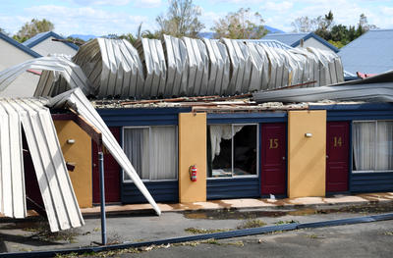
Case Study- Severe Tropical Cyclone Debbie
“After Severe Tropical Cyclone Debbie we had some damage from the event … debris, roof was loose and water in the shop.
But then some of the island resorts closed and the media really talked about that…
- So suddenly there was no tourists, no tours, no supplies needed for the islands – linen services, food, flowers, gift shops…
- it impacted so many businesses,
some for years.”
AAP image
Notes:
Here we have a short case study from the Whitsunday Coast in Queensland.
ACTION: Pause while participants read.
Highlights the cascading impacts of an event through a regional economy.

Slide 14
Effecting an entire economy
Local Government
Employees
Finance sector
A Business/Industry sector
Customer base and revenue
Creditors
Business
Business
Customer
Customer
Banks
Or a region
Business
Business
Customer
Insurance
Business
Suppliers
Suppliers
Primary Producers
Industry
Notes:
As mentioned, disaster impacts and their consequences flow through an affected community – it can be a ‘domino’ effect through the economy.
Loss of services like childcare, aged care and other support services can mean people are unable to get to work. This can have a flow-on effect to the local economy.
Economic impacts affect individual businesses, different sectors, locations, employment types (casual or temporary employees), supply chains, and over time with seasonal variations.
ACTION: Click through each element of the slide as instructed below.
Click – one business may be impacted but more often it will be multiple businesses
Click – multiple businesses
Click - might mean an entire business or industry sector may be impacted (such as tourism) – a key explorer in a community can dramatically impact a community recovery
Click – or multiple business
Click – may be all the businesses in a region are impacted either directly by the event of maybe downturn in a region resulting from the event (such as the earlier case study)
Click - there is also a relationship between a business and its employees
The relationship is two way
if a business is impacted and can’t pay employees this increases personal impact and tightening of family finances and
if the employees are impacted they mightn’t come to work as they are trying to re-establish family connections of clean up homes etc. so it is harder for the business to re-establish
Click – Customer relationships are also two way
Click – for example community losses
Click – may result in change in customer sentiment, a reduction of customer demand or changes to their disposable income
Click – A downturn in trade may mean suppliers are impacted – fewer orders for re-supply – means suppliers are also economically impacted
You can really see the ripples start to take affect.
The reverse is if suppliers are directly impacted but a business isn’t, the businesses will still have a shortage of stock, so customers go elsewhere
What if neither business or supplier are impacted but the transport and roads are?
Click – Economic impacts will also affect relationship with creditors,
Click – changes with banking or loans
Click – insurance or indeed across the finance sector which impacts businesses
Click – and also local government – rates relief provided may affect LGA capacity to deliver services
A local government will be impacted by all the things we have listed as well – all while trying to support it local community in recovery.

Slide 15

Primary Producers - some unique considerations
Repairs (e.g. fencing and agricultural infrastructure)
Psychological impact of destruction of livestock
Starting to source contractors and labour to do repairs
Depending on crop and/or produce - the loss of ability to generate income could be months or many years
Loss of bloodlines or genetic traits could have an impact for decades
HINT –
When a disaster hits primary producers, food production and supply is affected.
Recovery strategies need to be mindful that there are consequences for both producers and consumers.
Notes:
The dramatic impact and range of loss from disasters on primary producers can be less visible.
As well as livestock and crop damage – damage and loss of fences and essential business infrastructure such as farm machinery, water tanks and pumps and farm access roads, both private and local government assets can be lasting impacts.
Source contractors and labour to do repairs may be an issue particularly with many events source casual labour may be difficult as there is nowhere cost effective for workers to stay.
Depending on crop or produce - the loss of ability to generate income could be three months (for crops such as lettuce) or many years (for example some fruit, grapes or cattle).
For example: grapes in wine industry loss of 80-year-old vines is not just loss of grape production for a year or two – it is the loss of an ongoing brand and market share for 20 years (a company may not recover).
It is often not simply a process of easily replacing what has been lost. Similarly, loss of generational blood lines of livestock may never be able to be replaced.
When a disaster hits primary producers food production is affected and supply is affected, with consequences for both the producers and consumers, recovery strategies need to address this.

Slide 16
If we can understand the longer term economic impacts of disasters we can plan for these from the outset.
Include this understanding in early recovery planning to reduce the ripples as they flow out through the local economy.
Notes:
We cannot continue to pretend to be surprised.
Economic recovery must be at the forefront of recovery just like prioritising getting children back to school.
There is a wide range of work coming in about recovery including economic recovery. Including research findings and following the long term experiences of impacted communities.
Wherever possible, we should draw from these learnings to inform economic strategies and programs.

Slide 17
Common reactions to a disaster
Disasters are stressful and people can have a range of responses:​
Difficulty absorbing, processing and retaining information
Feeling paralysed and immobilised
Feeling overwhelmed
Inability to make decisions, even small ones – decision fatigue
Fearful for the future
HINT – It is important to take these things into account in the way you provide information, services and support for everyone …including business owners.
Notes:
People’s responses to disaster are typically normal responses to an abnormal event. It’s important to remember that reactions to grief and trauma can be confronting.
A lot of the information provided to communities are not focused on business owners.
Psychological impacts can be deep and lasting – and can affect how businesses approach recovery.
It’s important that support services are available for business owners to access when, where and how they need it. This includes support for emotional distress, mental health, family violence, drug and alcohol use, business mentoring and financial counselling.
Disasters are stressful and can have a profound impact on people’s mental health and wellbeing.
How can we as recovery practitioners ensure that information and recovery strategies are mindful of how business owners may be reacting and behaving following a disaster?
Simple communication and ensuring timely and appropriate awareness of what is happening and the variety of support available is critical for business owners.

Slide 18
The same disaster can affect different businesses differently
Although all impacted by a common event, all businesses will experience the disaster differently
All bring different challenges, capacities and resources into the experience of being impacted by a disaster
Businesses are not all the same when impacted by disaster. Therefore, their recovery, and recovery needs, will be different.
There is no standard approach for economic recovery
Notes:
The same disaster will affect different people in different ways. No two people or businesses will experience the disaster in exactly the same way.
There will also be many variations of pre-existing conditions and challenges that will impact how a business will recover.
There is no one size fits all approach – recovery strategies that work in cities and urban areas will need to be different in rural areas with primary producers.
A range of services and strategies must be provided to cater for the different and emerging needs of people.
Different strategies such as business recovery centres and mobile outreach teams and Rural Financial Counsellors.

Slide 19
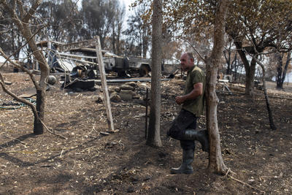
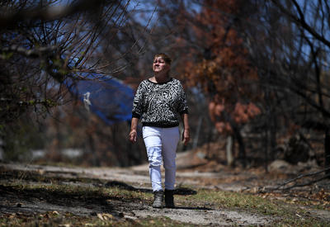
Case study
Primary producer
They saved the homestead…
But I lost the barn and sheds with all the feed and the machinery...
The home was insured but I don’t know how I can replace all that I have lost…
I have lost everything that I use to earn
a living.
AAP images
Notes:
Here we have another short case study this time from a primary producer.
ACTION: Pause for participants to read the case study.
This example highlights the tension between what is important to people and what is supported by insurance and other recovery programs and what isn’t.

Slide 20
Some often felt experiences
Influx of donated goods and relief organisations may impact on trade of local businesses
Impacts across other recovery environments –
  For example, transport of diary or produce out, services in, impacting on meeting contracts (e.g. aquaculture - seafood to market)
As the support teams leave, the initial economic injection they brought declines
Building and construction sector may pick up due to reconstruction while other sectors continue to face difficulties over extended timeframes.
Notes:
What strategies will assist in the economic recovery of the community?
We need to understand the vulnerability of business not just to disasters but in recovery … to misaligned support provided with the best intentions
We must work design and provide support we must first plan for the types of ongoing consequences that may be experienced.
Some examples of common experiences are:
the Influx of donated goods and relief organisations may impact trade of the local businesses in community they are trying to support
As the support teams leave, the initial economic injection they brought (accommodation, food restaurants/cafes and groceries) declines
Different levels of impact or speeds of recovery – for example the building and construction sector may pick up due to reconstruction efforts while other sectors continue to face difficulties over extended timeframes.

Slide 21
A partnership approach
Collaborate with trusted local business leaders and representatives to provide a vital conduit between the local economy and recovery structures.
Not every organisation and group can be on the Recovery Committee
However…
Recovery Committees must establish linkages across a range of organisations and networks to ensure they equitably support the economic recovery of the region.

Slide 22
Sustainability and adaptation
Disasters cause temporary and sometimes permanent damage to networks that affect local business and economies -
Day to day routines disrupted
People displaced from homes, businesses and communities (sometimes permanently)
Services and systems that people rely on are unavailable
Critical infrastructure damaged
This all affects the ongoing viability of businesses in a region over time.
Support is ending …
but I am still financially impacted!
HINT – there is no timeframe for recovery, spread support beyond the short and medium term.
Notes:
Disasters cause temporary and sometimes permanent damage to networks. All of these examples shown impact:
customers
Employees
Businesses.
For example: The closure of one business on a main street reduces the customer traffic for all businesses on that street… as there is one less reason for a customer to go to that location.
Another example - damage to road networks may mean:
damage crops on way to market
failure to get to market entirely – e.g., dairy farms are unable to transport milk
worker access
access to supplies and services.
Demand for support can grow as people who do not originally register
begin to see the benefits
Or cash reserves and insurance payments run out
those who have been receiving support from other agencies or funding bodies may be closed off and begin to seek further or alternate support.

Slide 23
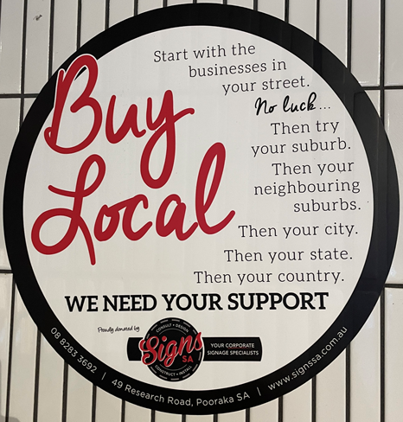
Principles – economic recovery into action
Develop an understanding of what is happening to inform next steps
The best outcomes are achieved when business and industry is returned to activity as early as possible
Take the opportunity to change and re-imagine businesses and communities to improve sustainability and resilience.
Management strategies and early planning
It is important to retain skilled workers in the affected area through paid employment
Encourage open for businesses and buy local campaigns
Coordination of recovery programs to align with/ support the economic recovery of business and industry.
Notes:
Here are some ideas and strategies for economic recovery adapted from the AIDR Community Recovery Handbook.
What staff do you need to deliver this work? Where are they? How to they link? (business continuity and future proofing).
The two key elements are:
develop an understanding of what is happening
use it to inform management strategies and early planning.
Business and/or industry representatives must participate in economic recovery decision making.

Slide 24
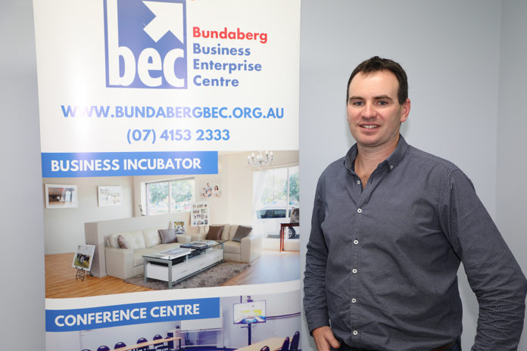
Principles – economic recovery into action
Service delivery
Enabling implementation and access to programs and support services though Business “hubs”
Build longer term business capability
Measures are taken to mitigate the impacts of future disasters.
Enabling initiatives
Support and promote opportunities for sustainable economic recovery
Advocate for the safe return of evacuees into the affected area as soon as possible
Facilitate the provision of grants, appeal and charitable payments as monies rather than material and goods. This supports rather than undermines economic and local business recovery.
Notes:
Ideas and strategies for economic recovery adapted from the AIDR Community Recovery Handbook.
What staff do you need to deliver this work? Where are they? How to they link? (business continuity and future proofing).
Enabling implementation and access to programs and support services though business ‘hubs’ – including support services such as financial counselling and business mentors.

Slide 25
Recovery funds don’t flow evenly through a local economy
Disaster events can have significant impact of the income trajectory of individuals and businesses in the longer term (in some cases over many years)
Low-income earners, small-business owners and part-time/temporary or casual workers are more likely to lose income following a disaster
Repairs and reconstruction support industry sectors such as construction
Other sectors may not be supported including services industries, (food, hospitality and tourism) and human & social services
These areas disproportionately employee females, youth and/or minority groups.
There are
long lasting financial impacts
HINT – tailor economic recovery approaches and programs for vulnerable businesses and individuals.
Notes:
There is a range of research now about long-term economic impacts from disaster events.
Deakin University conducted long term research looking at lasting economic impacts of disasters
The research highlights that the economic impacts of disasters are felt differently by particular segments of communities depending on their demographic attributes, employment characteristics and areas of residence.
Looking at disasters of different scales over the past 20 years researchers examining the:
2009 Black Saturday bushfires in Victoria, which killed 173 people and caused A$7 billion in damage
2010-11 Queensland floods, which killed 33 people and caused A$14 billion in damage
2013 Cyclone Oswald, which swept northeastern Australia and pounded the Queensland town of Bundaberg
2009 bushfires that destroyed 38 homes in the town of Toodyay, in Western Australia
Damage caused by a disaster - low-income earners, small-business owners and part-time workers, on average, lost income after a disaster.
For example: A casual employee at a restaurant may be asked not to come to work for a few weeks/months during a cleanup and recovery period.
Findings suggest most people never make up the income they lose, which may anything between $5k to $10k. Then when the restaurant is ready to reopen some staff may have moved on which may create future impacts on their business until positions are refilled. Also, customers may not immediately come back.
Those most likely to lose income following disasters are those employed in agriculture, accommodation, food services and the tourism industries.

Slide 26
Group Reflection
Economic recovery is about much more than just finance and numbers. It is about small businesses, primary producers, the families who run them and the important role that businesses play in supporting community life.
Communities depend on small business to provide access to food and materials to support every day needs and communities depend on the primary producers who grow and supply food.
Through tourism, small businesses provide the mechanisms that attract and support visitors to come and experience places of significance and recreation in the community – and the whole community benefits.
Successful recovery depends on economic impacts and consequences being considered across all the recovery environments: social, built and natural, as well as economic.
Notes:
ACTION: As introduction to the breakout session read through this slide with the whole group and then consider the questions on the next slide.

Slide 27
Break Out Group Discussion
Question 1. How is your recovery environment affected by the disaster impacts and consequences on businesses and primary producers?
Question 2. What recovery actions can your table group consider to support economic recovery?
  Where are the interdependencies with other environments?
  Who needs to be involved?
Notes:
ACTION: Break into table group discussion for 20 minutes.
ACTION: Leave this slide on screen for people to refer to.
ACTION: Have each group report back on their key learnings and discuss as large group plenary (duration: 10 mins).

Slide 28
Take away messages
Economic recovery is complex and always takes a long time.
Work to understand the longer term economic consequences of a disaster to plan for these from the outset.
Clean up, re-stocking and opening the doors isn’t
the end…
…it is just the beginning of economic recovery.
It is important to tailor economic recovery approaches and programs for those vulnerable businesses and individuals.
Disaster effects cascade through an economy
overtime …
Collaborate with the business sector to design the multiple types of support needed.
Notes:
ANIMATION

Slide 29
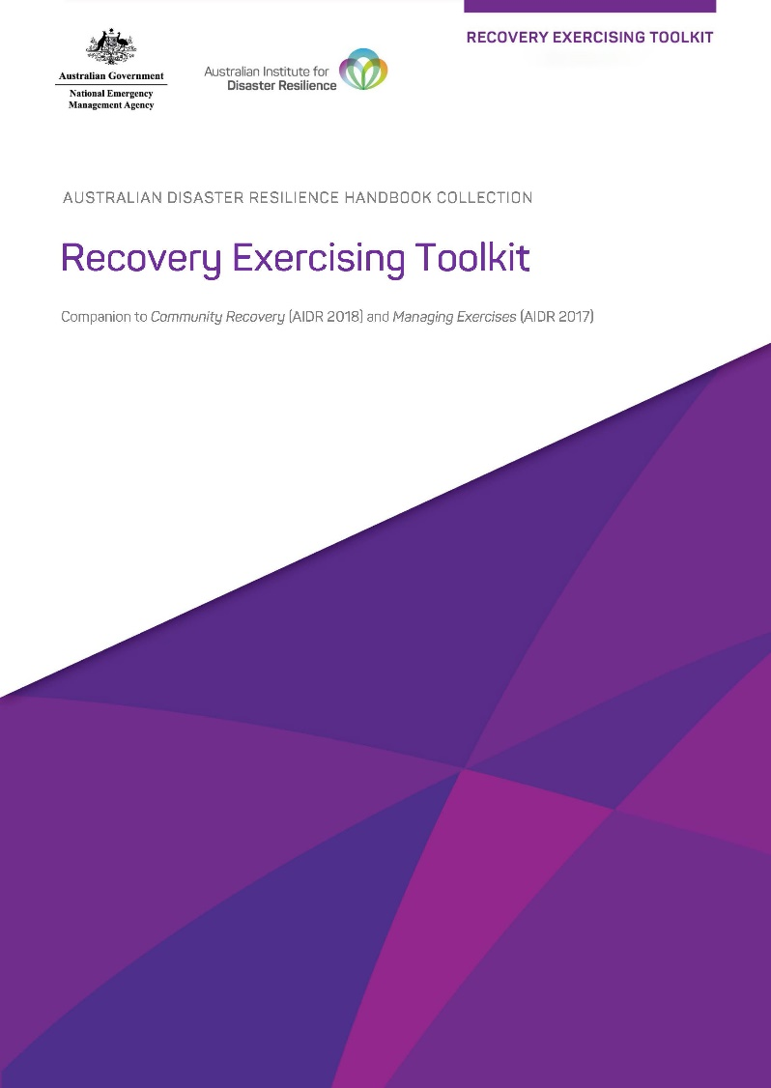
Recovery Exercising Toolkit
The Foundations of Economic Recovery Module Overview, Slide Deck and other resources are available in the Recovery Exercising Toolkit which can be found on the AIDR Knowledge Hub in the Recovery Collection.
Notes:
The content contained in this module is available in the Recovery Exercising Toolkit: https://knowledge.aidr.org.au/resources/recovery-exercising-toolkit/
ACTION: Encourage participants to access the information through the Toolkit and to explore what else the Toolkit has to offer to help build recovery capability in their committees and agencies.

Slide 30
Where to find out more
Australian Institute for Disaster Resilience, Community Recovery (2018)
This handbook aims to provide a comprehensive guide to community recovery in Australia. Section 4.3 focusses on Recovery of the Economic Environment.
knowledge.aidr.org.au/resources/handbook-community-recovery
Resilient Ready is the rebranded Corporate to Community and aims to build everyday resilience capabilities in organisations of any size, industry and structure.
Home - Resilient Ready
Biz Community Toolkit - Resilient Ready
Business.gov.au is a whole-of-government website for the Australian business community.
It is a simple and convenient entry point for information, services and support to help businesses succeed in Australia.
Emergency management | business.gov.au
Entrepreneurs' Programme | business.gov.au

