Slide 1
Working with Indigenous communities in disaster recovery
Notes:
NOTE TO FACILITATORS
The following slides provide you with a self paced walk through of the module, supported with speakers notes.
The package takes approximately 60 minutes to run, this includes the group discussion activity
Notes are in standard format. Facilitator actions are in bold italics.
It’s a good idea to print out a 'notes' version of the slide deck for your reference and use on the day.

Slide 2
We acknowledge the First Peoples of Australia and their ongoing strength in practising the world’s oldest living culture.
We acknowledge the Traditional Owners who have occupied and cared for the lands and waterways on which we depend for thousands of years. We acknowledge the (insert local Indigenous peoples and land) and pay our respects to their Elders past and present.

Slide 3
Indigenous Communities in
[Insert your region/local area]
Notes:
ACTION: If an Indigenous person is present, invite them to give an overview of the Indigenous communities in this region/area.
Who are the Indigenous communities in your region?
Who are the community-controlled organisations that provide services in your region?
What areas do local Indigenous peoples have formal recognised rights over Country and cultural heritage? (land and resources) in your region?

Slide 4
Objectives
Increased understanding of:
Intrinsic strengths and unique impacts of disasters on Indigenous communities
Importance of connection to Country
Role of Indigenous community controlled organisations in planning for and recovering from disasters
Need for engagement with Indigenous communities by emergency management agencies

Slide 5
An Indigenous Perspective of Disaster Recovery Bhiamie Williamson
Notes:
ACTION: You need to be in ‘slide show’ view to activate the link
Video length: 5:30 mins
https://www.youtube.com/watch?v=jcjUDLg10Q4
Bhiamie Williamson
Centre for Aboriginal Economic Policy Research Australian National University
Bhiamie Williamson is a Euahlayi man from north-west New South Wales with familial ties to north-west Queensland. Bhiamie is an academic who focuses on the impacts of disasters on Indigenous peoples including conducting case studies of both the 2019-20 bushfires and 2022 northern NSW floods.
In this video Bhiamie talks about how disasters disproportionally affect Indigenous Peoples, the importance of building relationships with Indigenous communities before disasters hit, and working with Indigenous communities to prepare for and plan for recovery from disasters.

Slide 6
Connection to Country
For Indigenous peoples, Country is more than a landscape. Indigenous peoples tell and retell stories of how Country was made, and continue to rely upon its resources — food, water, plants and animals — to sustain traditional ways of life.
“Healing Country, healing culture really matters. Until you heal Country and heal culture you can’t heal people.”
Sharon Riley, MINGAAN Wiradjuri Aboriginal Corporation
(Lithgow Mercury 12 November 2021)
Notes:
Indigenous people talk of, and to, Country, as they would another person. They see the land as a life giving sentient being with a consciousness, not a commodity or economic asset. Country also holds important heritage, including scarred trees, stone arrangements, petroglyphs, rock art, tools and much more
Relationship with the land is fundamental to the identity and way of life for Indigenous peoples.
Talking with local Indigenous communities about cultural heritage sites that may have been damaged by disaster, or new sites that have been uncovered (often by fire) is an important step in working together to inform priorities in environmental restoration and the ongoing care of the local environment

Slide 7
Disasters have unique impacts on Indigenous Peoples
“When disasters damage Country, the harm felt by Indigenous peoples can be particularly profound due to the deep connections between land, culture, history, colonisation and identity. Trauma can also arise from needing to relocate, and losing or being separated from loved ones and community”.
Recovery Capitals and Indigenous Peoples Resource
Notes:
The historical and unresolved legacies of colonisation also result in additional vulnerabilities for Indigenous communities in times of disaster. Indigenous peoples have experienced a unique trauma associated with racism and discrimination and damage to the land.

Slide 8
Health and social inequalities - Risk factors
Indigenous communities have distinct risk factors that are compounded in a disaster:
Overcrowded and multigenerational households
Poor health of residents
Lack of appropriate infrastructure
Lack of access to transport
Poor access to roads to evacuate.
Notes:
These health and social inequalities place Indigenous peoples at a higher risk of being more greatly impacted by a disaster and having to face more complex issues in their recovery.
These risk factors often stem from systems of inequity.

Slide 9
Notes:
This table demonstrates the differences in population profiles of Indigenous and non-Indigenous populations using 2021 census data.
The percentage of the Indigenous population under 25 years, and in particular under 15 years, is significantly greater than the non-Indigenous population.
The demographic profiles of Indigenous communities are characterised by a youthful population with a large age cohort of infants and young children. It is important to incorporate the needs of families with young children into emergency and recovery planning for Indigenous communities.

Slide 10
Aboriginal people are disproportionately affected by the impacts of the fires due to existing structural and financial inequalities, a backdrop of historical and intergenerational trauma, and the significant impacts that bushfires and bushfire protection has on Country and cultural heritage.
Victorian Government (2020), 2019-20
Victorian Government Aboriginal Affairs Report (p.12)

Slide 11
The Inquiry acknowledges that Aboriginal communities across the State were greatly affected by the bushfires…The Inquiry was disappointed to learn that in some communities Aboriginal people felt unwelcome at evacuation centres, and in some cases support services were reluctant to provide immediate relief. These experiences compounded the trauma they had already experienced as a result of the bushfires, and in some cases led to people putting themselves at risk as they feared how they would be treated.
Owens & O’Kane (2020), Final Report of the NSW Bushfire Inquiry(p.466)
Notes:
The Lived Experience of Indigenous People’s in Disasters
In recent years there have been many documented examples in post disaster Inquiries, reports and research papers which highlight how Indigenous peoples have not been supported during emergencies and evacuations, and in recovery.
There have also been many accounts from Indigenous people about their experiences after disasters that highlight that the way that people have been treated after disaster can be very harmful. This includes experiences in evacuation centres where Indigenous people have been subject to racism, felt unwelcome and have been refused service.
The quote on the slide is from the NSW Inquiry into the 2019-20 bushfires
The track record has not been good:
Emergency management agencies and NGO’s were ill-equipped to support Aboriginal communities in the response and in recovery.
Aboriginal people experienced a unique trauma associated with racism and discrimination and damage to the land.

Slide 12
Recovery approaches should be respectful of the history, culture, strengths and circumstances of affected Indigenous communities, including deep connectedness
RECAP Guide: Indigenous Peoples and Recovery Capitals
Notes:
Key Message

Slide 13
Creating culturally safe places in evacuation and recovery centres
Trauma can be worsened by disaster response and recovery services, including through racist encounters and culturally unsafe processes. Mainstream services and grants often fail to account for the particular experiences of Indigenous peoples. (RECAP)
Creating Safe Places
Publicly acknowledge the local Traditional Owners of the land that the centre is located on
Create a separate and safe space for Elders
Have adequate facilities for families with children and babies
Invite the local Indigenous organisations to be present in evacuation and recovery centres
Provide evacuation and recovery centre staff and volunteers with cultural awareness training.
Notes:
Supporting Indigenous peoples in culturally appropriate and culturally centred ways is incredibly important so that Indigenous peoples can have the same access to safety and services as everyone else.
There are some simple ways to make culturally safe spaces that will help Indigenous peoples feel welcome in evacuation and recovery centres.
These considerations should be included in evacuation and recovery centre planning and audits.

Slide 14
Intrinsic strengths of Indigenous communities
Indigenous communities are often referred to as ‘vulnerable’, however these ‘vulnerabilities’ are not inherent characteristics of Indigenous peoples, but stem from systems of inequity
There are many strengths that exist within Indigenous communities. These include having:
extensive familial and cultural networks that can be mobilised in times of crisis
advocates that are quick to bring attention to community needs
healing frameworks that are called upon to support communities in times of hardship
community-controlled organisations that have well-established and trusting relationships with communities.
Notes:
Indigenous communities are often referred to as ‘vulnerable’, however these ‘vulnerabilities’ are not inherent characteristics of Indigenous peoples, but stem from systems of inequity.
These strengths are a powerful resource that are often overlooked. These strengths must be recognised and embedded within larger disaster response and recovery efforts.
Indigenous communities are resilient, they have demonstrated the ability to withstand extreme events and adjust to new norms over thousands of years.
Indigenous art and storytelling provide a powerful avenue for Indigenous communities to express identity and culture, self-determination and understanding. Indigenous art can be incorporated to support community planning for disasters and planning for recovery, as well as being a powerful healer for community expression of grief and hope after disaster

Slide 15
Indigenous community organisations are an asset in recovery
Indigenous community-controlled organisations are governed by their communities
They know their community and can provide critical information about local populations
There is a level of trust, or at least familiarity, between Indigenous peoples and the organisation
Indigenous community members are more likely to access these organisations before accessing non-Indigenous organisations or government agencies.
Notes:
Indigenous community controlled organisations are governed by their communities. They provide critical information about local populations such as distribution, families (large, small, size structure), visitors (such as families visiting in school holidays) health of local people, number and location of Elders, mobility (who does and does not have access to transport), avoidance relationships (AVOs).
There is a level of trust, or at least familiarity between Indigenous peoples and the organisation. This means that Indigenous community members are more likely to access these organisations before accessing non Indigenous organisations or government agencies.
Indigenous community controlled organisations have a critical role to play in disaster planning and preparedness, during, in the immediate aftermath of a disaster and in recovery. These organisations can provide a vital conduit between Indigenous communities and emergency management structures. They know and understand the impacts on their community, they have important knowledge and resources to contribute and must be included/linked with formal recovery plans, structures and arrangements.
It’s important to remember that disasters also directly impact on the capacity of Indigenous controlled community organisations to continue their services, often when demand from community has greatly increased. Recovery Committees should consider what extra resources and additional funding support can be provided.

Slide 16
Planning for recovery with Indigenous Communities
Establish authentic relationships of partnership with Indigenous peoples as valued and equal recovery decision-makers, before disaster hits.
How have Indigenous peoples been impacted by this disaster? Consider residents, distinct communities and legal rights and interest in the land as First Peoples. Consider also the deep connections between land, culture, history, colonisation and identity.
Develop and maintain strong working relationships with local Indigenous organisations. Be guided by these organisations and Elders to centre Indigenous peoples’ voices in developing recovery strategies which minimise the risks of exacerbating existing trauma and vulnerability.
Strategies should recognise and build on the strength and resilience of Indigenous communities.
RECAP Guide: Indigenous Peoples and Recovery Capitals
Notes:
Exercising self-determination in recovery from disaster is vital for Indigenous communities. However, historically there has been limited engagement with Indigenous peoples in the development of emergency and recovery plans and the specific needs of Indigenous peoples have not been well considered in response and recovery programs.
Local emergency and recovery planers must take into consideration the unique impacts of disasters on Indigenous communities and work alongside Indigenous communities to identify what support is needed and how this support will be organised and delivered in emergencies and in recovery. The only way this planning can be effective is to include Indigenous people and Indigenous community controlled organisations in the planning process. Inclusion and collaboration with Indigenous peoples will help to ensure access to the same level of support as the rest of the community.
Indigenous community controlled and representative organisations have a critical role to play in disaster planning and preparedness, response and recovery. These organisations can provide a vital conduit between Indigenous communities and emergency management structures. They know and understand the impacts on their community, they have important knowledge and resources to contribute and must be included/linked with formal recovery plans, structures and arrangements.
RECAP Guide: Indigenous Peoples and Recovery Capitals
How can recovery be enhanced by listening to Indigenous people’s experiences and deep knowledge of resilience, healing and how to live with Country?

Slide 17
Group Discussion on: How can you strengthen partnerships with local Indigenous leaders and Indigenous community-controlled organisations? What can you do in your role, in your organisation, to work more closely with Indigenous communities in planning for recovery?
Notes:
ACTION: Break into table group discussion for 20mins
ACTION: Leave this slide on screen for people to refer to
What can you do differently in your role, in your organisation, to support working with Indigenous communities in planning for recovery?
ACTION: Have each group report back on their key learnings and discuss as large group plenary – 10 mins

Slide 18
Take away messages
Indigenous communities have intrinsic strengths that are often overlooked in recovery
Indigenous peoples are disproportionately affected by the impacts of disasters due to existing structural and financial inequalities
When disasters damage Country the harm felt by Indigenous peoples can be profound
Culturally informed approaches are essential for recovery and healing
Indigenous community-controlled organisations have an important role to play in planning for recovery

Slide 19
Suggested next steps
Review your emergency and recovery plans. How do your planning processes include local Indigenous Communities? How do your plans reflect:
the strengths and assets of Indigenous peoples
the unique needs of Indigenous peoples in evacuation and recovery
the Indigenous community-controlled organisations who can provide information and support
the formal recognised rights over Country and cultural heritage of local Indigenous peoples
Meet with local Indigenous Elders and community-controlled organisations to plan together how local Indigenous communities can best be supported through an emergency and in recovery.
Establish formal mechanisms of engagement such as a Community Organisations Recovery Reference Group that includes Indigenous community-controlled organisations.
Encourage recovery practitioners from government and non-government agencies to undertake Indigenous cultural awareness training.

Slide 20
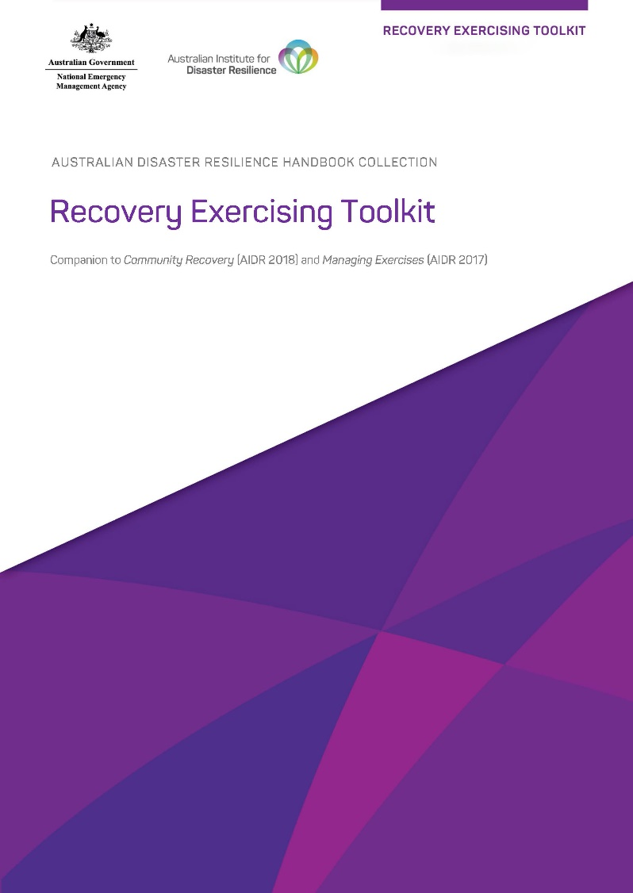
Recovery Exercising Toolkit
The Working with Indigenous Communities in Recovery Module Overview, Slide Deck and other resources are available in the Recovery Exercising Toolkit which can be found on the AIDR Knowledge Hub in the Recovery Collection.
Notes:
The content contained in this module is available in the Recovery Exercising Toolkit on the AIDR Knowledge Hub: https://knowledge.aidr.org.au/resources/recovery-exercising-toolkit/
ACTION: Encourage participants to access the information through the Toolkit and to explore what else the Toolkit has to offer to help build recovery capability in their committees and agencies.

Slide 21
Where to find out more
Williamson, B (2022). Aboriginal community governance on the frontlines and faultlines in the Black Summer Bushfires (CAEPR Discussion Paper No. 300/2022). Centre for Aboriginal Economic Policy Research, ANU Aboriginal Community Governance on the Frontlines and Faultlines in the Black Summer Bushfires | Centre for Aboriginal Economic Policy Research (anu.edu.au)
Recovery Capitals (ReCap), supports wellbeing after disasters with evidence-based resources for people and organisations engaged in recovery.
Quinn P, Williamson B, Gibbs L. Recovery Capitals and Indigenous Peoples Resource. Melbourne, Australia: Bushfire and Natural Hazards Cooperative Research Centre. April 2021. Recovery Capitals
Indigenous Peoples and Recovery Capitals Resource
Indigenous Peoples and Recovery Capitals - Phoenix Australia Disaster Mental Health Hub
ABC Podcasts – After the Disaster, Episode 12 – Communities with trauma
Ep 12 | Communities with Trauma - ABC

