Slide 1
Recovery Considerations
12 months and beyond
Notes:
NOTE TO FACILITATORS
The following slides provide you with a self paced walk through of the session, supported with speakers notes.
Notes are in standard format. Facilitator actions are in bold italics.
You don’t have to use all slides. Link in your local knowledge and examples to make content relevant to participants
The presentation takes approximately 15 minutes to go through
The main focus of this session is the group discussion activity – allow 25 minutes for discussion

Slide 2
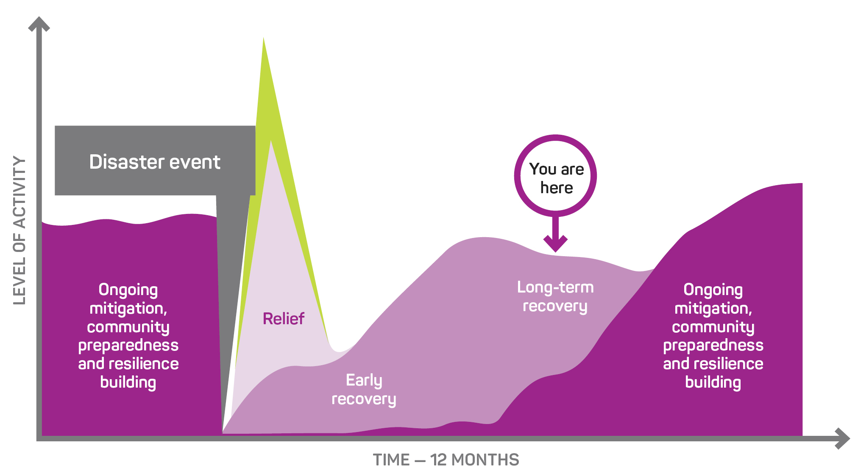
Notes:
The Recovery Journey
The recovery journey follows the disaster event scenario and explores the community consequences and emerging issues that communities will face over time.
At 12 months post the disaster event, communities are likely to still be in the medium to longer term recovery phase. The timing will depend on the severity and complexity of disaster impacts, with community members still grappling with many of the consequences of the disaster and changes to their lives.
This slide helps participants to see how this phase fits in the broader recovery journey.

Slide 3
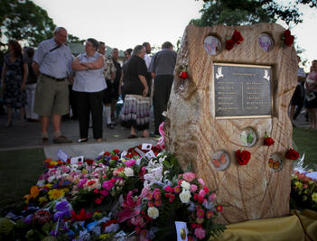
What is happening in the community at 12 months?
First year anniversary memorials and commemorations
Increase in mental health issues, substance abuse and family violence
People are still presenting for help and assistance for the first time
Return of disaster ‘season’ (fire, flood, cyclone) retriggering trauma and feelings of anxiety and distress.
Funding for short-term recovery services and contracts for recovery officers often conclude at 12 months, just at the time the community is facing anniversaries which often result in heighted need for community support.
Recovery Tip: Avoid concluding recovery services and workers at the 12-month mark, as this is often when recovery needs are high.
AAP images
Notes:
First year anniversary events and memorials will be occurring, can sometimes cause conflict in the community – some want to stop and remember and others want to move on – can also mean a renewed media focus, which is not always welcomed.
People are still presenting for help and assistance for the first time.
People may not initially reach out for support and be reluctant to do so for a range of reasons, such as feeling:
that others are worse off than them
they don’t deserve support or financial assistance
they have never accepted financial support before and not familiar with government and other appeal fund processes
they are able to manage on their own without support (practical, personal or financial)
they don’t want to share their personal details and information often required for support to flow.
Its often many months or even years down the track when people have exhausted all their own options and no longer feel they are managing that they will reach out for help. Recovery support services need to be in place over the longer term so that they are available for people when they need them.
Emergence of trauma responses in children and young people (e.g. nightmares, depression, post-traumatic stress, self-harm).
Return of disaster ‘season’ (fire, flood, cyclone) often resulting in heightened anxiety and distress. People may be triggered by the smell of smoke, sound of rain.

Slide 4
Homes and Property
Rebuilding is underway - but few homes completed and many not started
Unresolved insurance claims and underinsurance issues
Shortage of tradespeople, limited supply of building materials and increased costs
Contributing factors to slowed recovery and increased stress, anxiety and emotional fatigue
Increased housing stress and homelessness
Many people still in insecure temporary accommodation
Scarcity of rentals and escalating rental costs
Increasing mortgage interest rates
No redundancy in local housing stock to absorb another disaster event
Notes:
Increased and sustained demand has ‘overheated’ the market, making repairs, contractors and materials more expensive than what was budgeted/quoted/insured for. This will be contributing to a range of unresolved claims and stress for policy holders.

Slide 5
The Long Road to Recovery – 3 Case Studies
Townsville Floods (January 2019)
Homes repaired by the 12-month anniversary
Notes:
The road to recovery for impacted individuals is a long journey – One example is the rebuilding of homes.
The following slides provide examples from several communities and events.
Townsville Floods, January 2019 – 12-month anniversary: January 2020
According figures from the Queensland Reconstruction Authority, of the 3,300 flood-damaged homes, 1,800 were still damaged and 740 still uninhabitable 12 months after the event.
This means that nearly 50% of the homes damaged in the flood were still damaged 12 months later.
More than 25% of the homes were uninhabitable.
In the suburb of Fairfield Waters about 1 in every 10 houses still had tradesmen working on flood repairs while some houses remained empty or with work yet to start.
For many, ongoing insurance negotiations are contributing to their slow recovery.
Sarah Little and Chris Baker are living in a half-repaired house and using a portable ensuite as they do not have a functional bathroom. Ms Little said their insurer had ‘pulled the pin’ on their claim and their house was being held together by plywood panels.

Slide 6



NSW South Coast Black Summer fires January 2020
2 year anniversary: Home rebuilding rates at November 2021
Bega Valley and Eurobodalla
Bega Valley
1,000 Homes lost
7.5%
Finished rebuilding
467 Homes lost
117
Applications to rebuild
Three in four families have not even commenced the planning process
Notes:
Guardian Australia Rural Network, 9 November 2021
In two of the worst-hit local government areas, Bega Valley and Eurobodalla, almost 1,000 homes were lost. Data obtained by Guardian Australia shows that barely 7.5% (less than 10%) of survivors have finished rebuilding.
Across the Bega Valley, of 467 homes that were lost, the council has received only 117 applications to rebuild. In other words, three in four families have not even commenced the planning process two years after the fires (Guardian Australia Rural Network, 9 November 2021)

Slide 7
East Gippsland 2019/20 Black Summer bushfires
September 2022 (2 years on)
In East Gippsland - just over 15 per cent of the homes impacted by the 2019/20 Black Summer Bushfires have been replaced according to a draft report prepared by East Gippsland Shire Council and Bushfire Recovery Victoria.
Multiple impacts have led many property owners to draw the conclusion that they do not have the capacity to rebuild.
Further research is being conducted to understand barriers.

Slide 8
There are lasting financial impacts
Disaster events can have significant impact of the income trajectory of individuals and businesses in the longer term (in some cases over many years)
Low-income earners, small-business owners and part-time/temporary or casual workers are more likely to lose income following a disaster
Repairs and reconstruction support industry sectors such as construction
Other sectors may not be supported including service industries (hospitality and tourism) and human and social services
These areas disproportionately employee females, youth and/or minority groups
Tailor economic recovery approaches and programs for those vulnerable businesses and individuals in communities
Recovery funds
DO NOT
always flow evenly through a local economy
Notes:
There is a range of research now about long-term economic impacts from disaster events.
Deakin University has conducted long term research looking at lasting economic impacts of disasters:
The research highlights that the economic impacts of disasters are felt differently by particular segments of communities depending on their demographic attributes, employment characteristics and areas of residence.
The research examined a range of disasters of different scales over the past 20 years, with researchers examining the impacts on households across multiple years:
Damage caused by a disaster: low-income earners, small-business owners and part-time workers, on average, lost income after a disaster.
For example - a casual employee at a restaurant, may be asked not to come to work for a few weeks/months during a cleanup and recovery period.
Findings suggest most people never make up the income they lose, which may anything between $5k to $10k. Then when the restaurant is ready to reopen some staff may have moved on which may create future impacts on their business until positions are refilled. Nor may customers immediately come back.
Those most likely to lose income following disasters were employed in agriculture, accommodation, food services and the tourism industries.

Slide 9
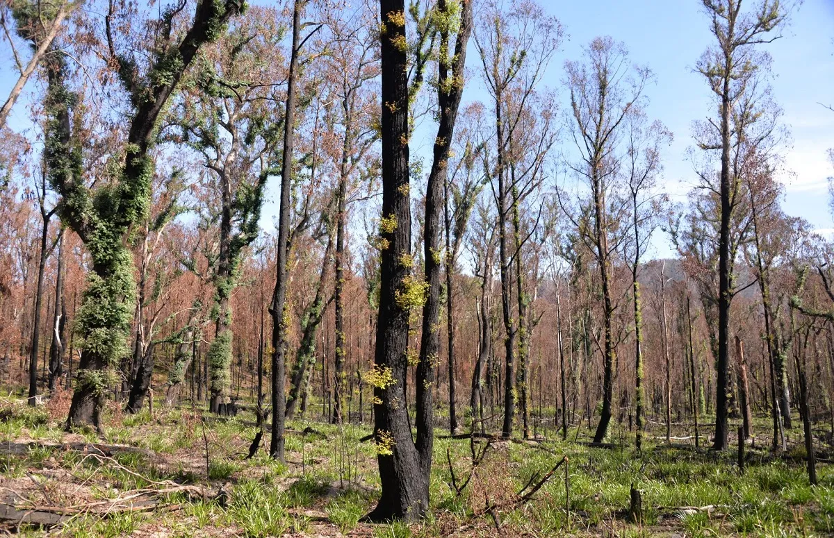
Environmental Recovery
Rejuvenation and Biodiversity
Two years after the Black Summer bushfires, we are still developing an understanding the environmental impacts and consequences
Protection of threatened species and their habitats
Increasing resilience through new sanctuaries and prioritised species genetic management
Changed landscape has lasting impacts on psychological wellbeing, particularly for Indigenous Peoples who are deeply connected to land
Healing Country and enabling
Traditional Owner land management
Image from CSIRO report into environmental impacts of the Black Summer Bushfires in NSW
Notes:
It is not unusual in the years post an event that there are still ongoing refinements/understandings of event impacts and consequences – environmental recovery programs are not short term with outcomes taking years to manifest
For example - while it is difficult to estimate the exact number of native animals impacted by the Black Summer bushfires, some experts originally predicted it could be as many as 800 million in NSW and one billion nationally, with more recent analyses suggesting as many as three billion nationally.
The impacts of megafires, or large-scale flooding and cyclones, on biodiversity can be severe, so conservation managers must be able to respond rapidly to quantify their impacts, initiate recovery efforts and consider conservation options within and beyond the burned extent.
The long-term changes to landscapes have lasting impacts on individual and community wellbeing. These impacts are felt deeply by local Indigenous Peoples for whom Country is more than a landscape, and holds important heritage, including scarred trees, stone arrangements, petroglyphs, rock art, tools and much more. Indigenous Peoples are deeply connected to the land - recovery of the environment and recovery of the community are the same thing for Indigenous communities.
Talking with local Indigenous communities about cultural heritage sites that may have been damaged by disaster, or new sites that have been uncovered (often by fire) is an important step in working together to inform priorities in environmental restoration and the ongoing care of the local environment

Slide 10
Transitioning from Recovery Committees
Recovery committees established under state or territory emergency and recovery governance arrangements generally close once there is no longer a need for a central coordinated approach to recovery across sectors and agencies.
When a disaster has had a significant impact on a community, a government established recovery committee will usually run for up to 2 years and in some cases longer.
Community recovery committees may continue for many years.
Notes:
The transition from coordinated recovery involves the planned withdrawal of recovery services, linking back to mainstream service and the restoration of community functioning.
Formal regional/local recovery committees established under state or territory emergency and recovery governance arrangements can close once there is no longer a need for a central coordinated approach to recovery across sectors and agencies. This doesn’t mean that recovery is over, it simply means the recovery is entering a new phase and ongoing strategies and actions are absorbed into council planning, local services and the day to day functioning of the community and it’s activities.
Not everyone in the community may feel ready to transition out of recovery at the same time and it is common to see different levels of dissatisfaction and distress about where recovery is up to. While there may be individual variations, transition needs to be informed and reflect what is happening in the community more broadly.

Slide 11
When to close a recovery committee
Indicators for closure of a recovery committee and/or its subcommittees can include:
Actions and strategies identified in recovery plans have been completed
Recovery work is being absorbed into the mainstream of agencies normal business
Recovery work is absorbed by local workers and services
Businesses are back up and running

Slide 12
Closing the recovery committee doesn’t mean that recovery is over.
It simply means the community is entering a new phase in recovery.
Ongoing strategies and actions are absorbed into council planning, local services and the day to day functioning of the community and it’s activities.

Slide 13

Looking forward
Notes:
Two years and beyond
The timing for the community to move through these phases will depend on the severity and complexity of disaster impacts experienced by the community. In significant disasters longer- term recovery can continue for many years, but over time the community will transition from recovery to mainstream services and ongoing community development, renewal and regeneration and a focus on disaster mitigation, preparedness and resilience building.
This slide helps participants to see how this phase fits in the broader recovery journey.

Slide 14
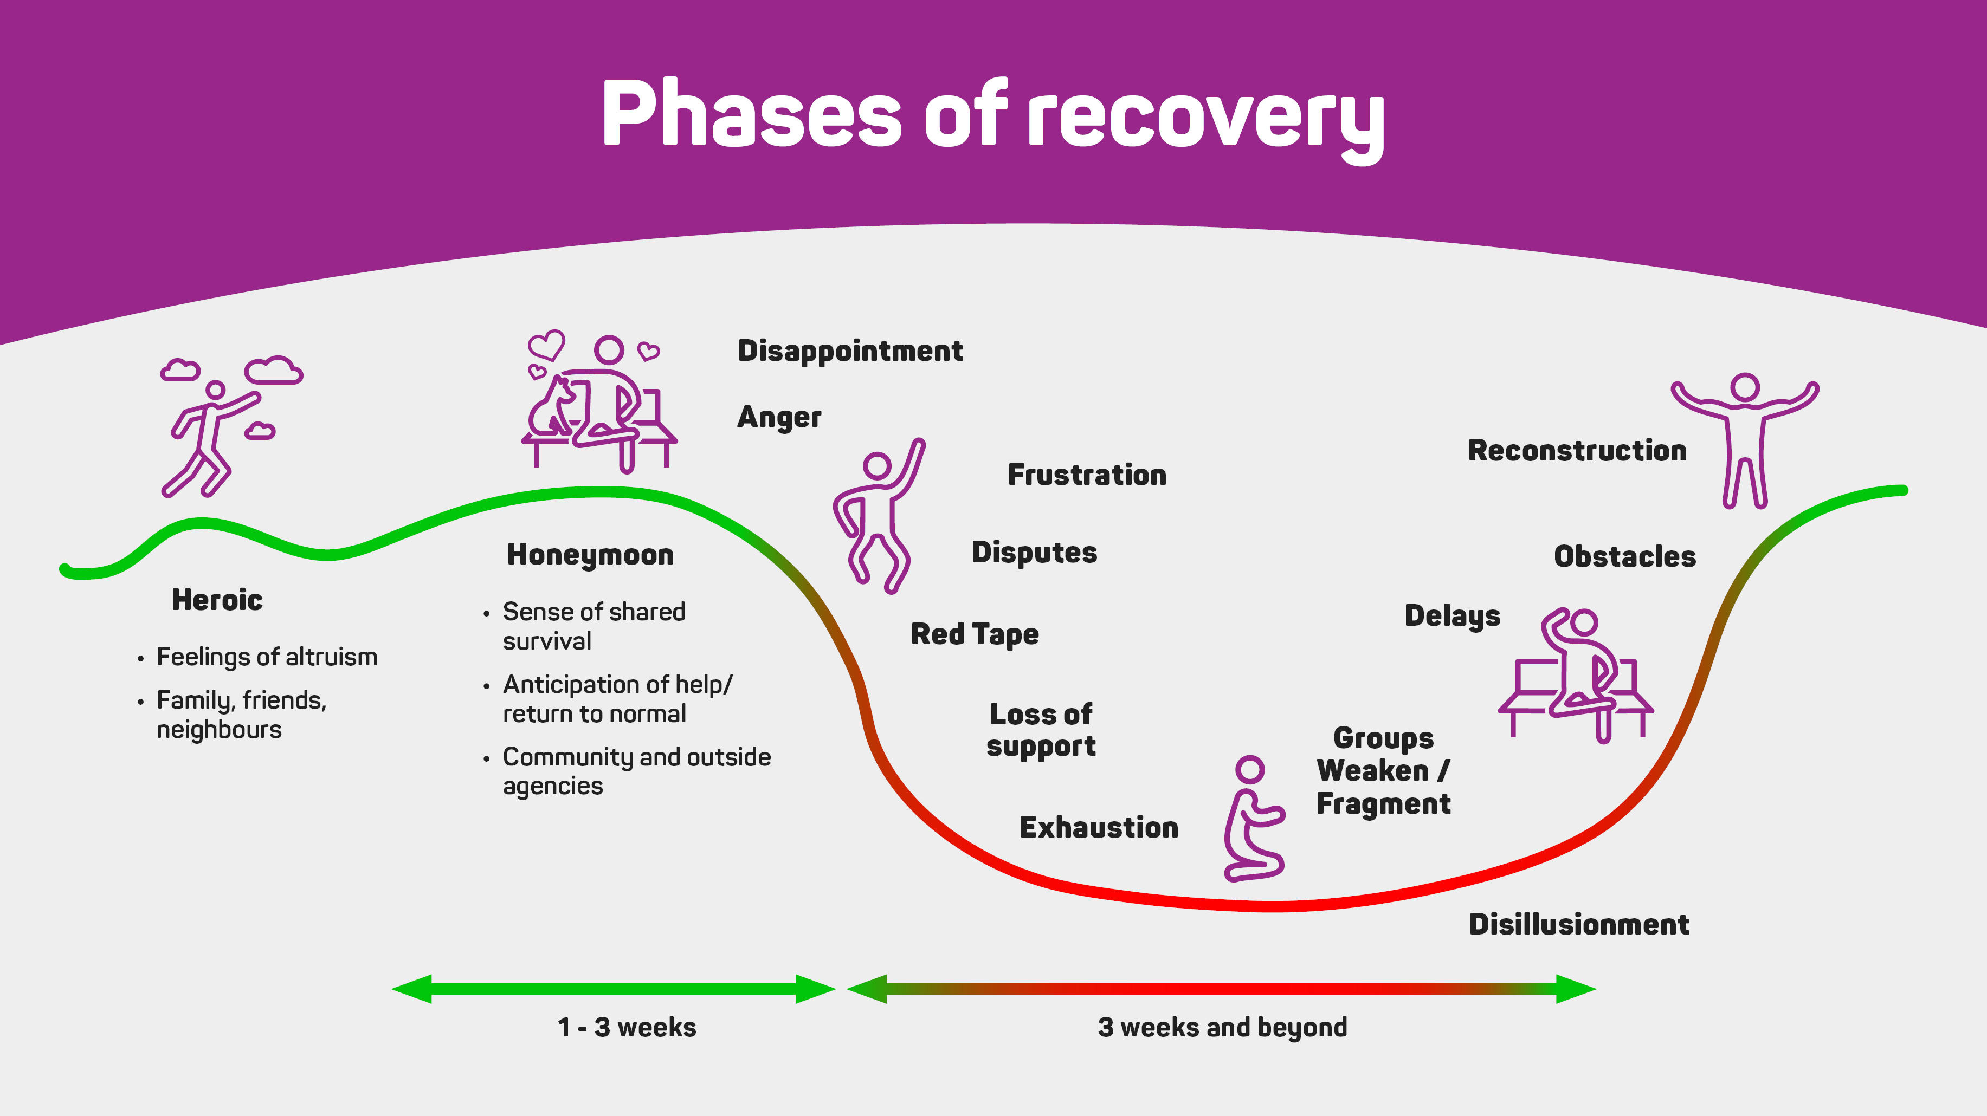
Notes:
ACTION: Group Question
12 months, 2 years and onwards - What point do you think we are at now on the recovery journey?
People are likely to still be in the ‘red zone’ experiencing disillusionment delays and obstacles- particularly in relation to rebuilding. Eventually over time (which is always different, depending on the nature and complexity of impacts) people will reconstruct their homes/properties, find secure rental accommodation (in the same or different location).
Remember that reconstruction is not just about bricks and mortar, but about people building and leading a life that they value living, even if it is different to the life they were leading before the disaster event.

Slide 15
2 years and beyond – recovery activities
Many grants and funding packages will be ending, creating a ’funding cliff’
Transition to business as usual with ongoing support (many of those early strategies from 3 months are still needed)
Recovery programs are still being delivered but may need to be adjusted as needs change
Long term resilience and sustainability is now a focus
Many people still living in temporary accommodation and caravans – ongoing need for rebuilding support
Notes:
Events can live on within the community memory – there may be an increase in physical health ailments as a result of the event.

Slide 16
10 Years Beyond Bushfires Report: key findings
A slump in life satisfaction from 3 to 5 years after the bushfires, which improved again at 10 years after the bushfires
Ten years after the fires, 22% of people were reporting symptoms consistent with a diagnosable mental health disorder
Around 10% of people in high-impacted communities reported anger problems 5 years after the fires.
In the first 3 to 4 years following the bushfires, reports of violence experienced by women were 7 times higher in high bushfire-affected areas
A sense of community cohesion was lower in high-impact communities 10 years after the bushfires
Loss of income, property loss and relationship breakdown increased the risk of mental health impacts
Notes:
10 Years Beyond Bushfires Report 2021
University of Melbourne
Gibbs L, Molyneaux R, Harms L, Gallagher H C, Block K, Richardson J, Brandenburg V, O’Donnell M, Kellett C, Quinn P, Kosta L, Brady K, Ireton G, MacDougall C, Bryant R. 10 Years Beyond Bushfires Report 2020. University of Melbourne, Melbourne, Australia
The Beyond Bushfires: Community, Resilience, and Recovery study was conducted to examine the impacts of the 2009 Victorian bushfires, including Black Saturday, on the mental health and wellbeing of community members, with a focus on how individual outcomes were influenced by social connections and community-level recovery.
The research was extended into the 10 years Beyond Bushfires study and a range of related disaster research studies. Well over 1,000 participants generously shared their experiences for this study through either community meetings, repeated surveys (3-4, 5 and 10 years after the fires) or in-depth interviews (3-4 years after the fires).
The study aimed to build an understanding of longer-term recovery and the ongoing impacts of a major disaster experience, to identify where support is needed for those affected and to guide preparedness and recovery from future events.
If we now know that these are the impacts out of significant disasters, how do we plan recovery strategies from the outset that can respond to these risk factors?

Slide 17
If we can understand the expected longer term, community impacts of disaster we can plan for these before they occur
Lessons from previous events, exercises, reports and research can inform future recovery planning and preparedness
Plan early for the known recovery challenges in your community
Prepare for recovery
Notes:
While every disaster and subsequent recovery is different, our learnings and experiences over time have taught us that there are many challenges and needs that commonly occur, that would benefit greatly from pre-planning. We do not have to wait for a disaster to occur and for the community to experience the issue/need before commencing recovery planning.
Drawing on the research, identified lessons from reviews and evidence-based practice as they apply to recovery considerations across the short, medium and longer term phases of recovery help us to anticipate challenges before they arise and have recovery strategies ready to activate when needed.
Planning for known recovery challenges and having strategies and plans in place before a disaster event occurs is an important step in ‘being prepared for recovery’.

Slide 18
Core Recovery Strategies 12 months and beyond
Social
Memorials and commemorations
Temporary Housing plan and pathways
Wellbeing and mental health programs
Programs for children and young people
Recovery Case Management Services
Community events and activities that support community connection
Creative Arts Practice Programs
Environment
Continue rejuvenation of the natural environment
Raise awareness of and promote community involvement
Multi year projects
Land based natural area restoration priorities
Stabilise, rehabilitate and restore riverine, wetlands and coastal areas
Re-establish and support biodiversity
Notes:
Core Recovery Strategies are a reference document for table group discussions.
They do not provide a comprehensive list of strategies and are not tailored for your specific scenario.
They are intended as a starting point to inform in recovery group discussions.
ACTION: Do not present these slides in detail. Familiarise the group with these slides and remind them of their purpose to support group discussion.
It is useful to note how the strategies change over time, there are a number of strategies implemented in first three months that will need to continue for months and years after the disaster.
Other strategies are introduced over time as new recovery needs are identified.
ACTION: Print copies and place on table groups as reference documents.

Slide 19
Core Recovery Strategies 12 months and Beyond
Built
Restoration and reconstruction of community recreational facilities including sports grounds and facilities, parks and conservation estates
Restoration and reconstruction heritage buildings
Ongoing support for rebuilding
Building advisory services for homeowners
Build back better initiatives
Digital infrastructure and connectivity
Economic
Businesses
Business Recovery and Advisory Services
Mentoring, training and development programs
Employment strategies to retain workers in areas
Public private partnerships
Supporting diversification in local and regional economies
Primary producers
Financial strategies to support the many producers who still wont have re-established cash flow

Slide 20
12 months and beyond
Considering the community consequences and emerging issues at this stage of recovery:
What are the priority planning actions in response to these issues?
How has your recovery sub-committee membership changed over time?
Notes:
ACTION: Instruct groups to continue record their discussions on the templates provided.
ACTION: Ask participants to highlight 2 priority issues and actions for the 12 months and beyond timeframe to report back on in the plenary session.
ACTION: Remind participants that report back on discussions from the three Recovery Consideration sessions will be after Afternoon Tea. As this is the last session before the Plenary Group ask participants to prepare to present the following and identify a spokesperson:
What was a key recovery consideration for each time period and what were your priority actions?
What issues have you identified that would benefit from further planning for inclusion in recovery plans and strategies?

