Slide 1
Recovery Considerations 3 weeks – 3 months
Notes:
NOTE TO FACILITATORS
The following slides provide you with a self paced walk through of the session, supported with speakers notes.
Notes are in standard format. Facilitator actions are in italics and bold.
You don’t have to use all slides. Link in your local knowledge and examples to make content relevant to participants.
The presentation takes approximately 15 minutes to go through.
The main focus of this session is the group discussion activity – allow 15 minutes for discussion.

Slide 2
Notes:
The Recovery Journey
Recovery activities commence when a community first experiences disruption or is impacted by a disaster event. This is usually at the same time as response activities are underway. However for the purpose of the recovery exercise today, the focus begins at early recovery - three weeks post the scenario disaster event. This helps to keep the exercise focus forward looking from the early, to medium to longer term phases of recovery.
The recovery journey explores the community consequences and emerging issues that communities will face over time. The timing that communities will move through these phases will depend on the severity and complexity of disaster impacts.
At the three-weeks post disaster point, communities are starting to move beyond immediate relief into early recovery.
This slide helps participants to see this point of early recovery and how it fits in the broader recovery journey.

Slide 3
3 Weeks Post Disaster - Recovery Arrangements have been activated
A Natural Disaster Declaration for the LGAs of XXX has been made.
A Recovery Committee has been established.
The relevant Relief and Recovery Arrangements and Disaster Assistance Measures (under DRFA) have been activated such as: * List your State/Territory Assistance Measures *
The Australian Government Disaster Recovery Payment (AGDRP) and the Disaster Recovery Allowance (DRA) may also have been activated.
Notes:
ACTION: Please update terminology as appropriate for your jurisdiction.
The intent of this slide is to provide a high level snapshot of the recovery arrangements that would be in place three weeks post a disaster event.
This should cover, local, state/territory and federal government support arrangements

Slide 4
3 Weeks Post Disaster - Recovery Activities
Evacuation/Relief centres have closed
Recovery Centres/Hubs are still open
Outreach activities and community meetings are underway
Out of area volunteer groups are still operating
Impact assessments complete and needs assessments have commenced
Councils are supporting communities whilst managing impacts on council buildings, programs and staff
Clean-up has started
Supporting whilst impacted
Impacts to Public Administration buildings have also had an impact on LGs infrastructure and some operations
Notes:
The first three months after disaster are extremely busy, with needs assessments and the development and implementation of recovery strategies that need to be rolled out as soon as possible to support communities.
It’s also useful to note how the strategies change over time, there are a number of strategies implemented in first three months that will need to continue for many months and years after the disaster.
Three weeks after an event, recovery will begin to be a focus. Some of the key recovery activities at this early stage would include:
Local government are supporting communities whilst being impacted including LGA building and infrastructure, operations and staff themselves
Evacuation/relief centres have closed
Recovery centres/hubs are open
Outreach activities and community meetings are underway
Out of area relief groups are still operating
Impact assessments complete and needs assessments have commenced
Clean up is underway

Slide 5
What is happening in the community at 3 weeks
Local organisations are likely to be overwhelmed with donated goods
Numbers of volunteers will start to taper off, even though there is still much to do
People are beginning to return to work and schools are reopening
Insurance assessments are underway
Information starting to come through about appeal funds and grants
Media attention is starting to shift away from the disaster
Notes:
What is happening in the community at three weeks
This touches on some human and social elements of recovery and what community members will be experiencing and feeling:
Community tensions emerging about eligibility for donations and assistance
Numbers of volunteers will be tapering off, even though there is still much to do
Community members, organisations and groups who have been active since event start will now be feeling intense fatigue
There will be risks of competing for community spaces and impacts on local businesses
Information about post-trauma support, appeal funds and grants are becoming available – this will need to be regularly provided to ensure people see it when/as they begin to become aware that they need it
Communities may start to feel ‘forgotten’ by the wider world as media attention shifts away from the disaster event
People are beginning to return to work and schools open or relocated (which may mean that families are ‘separating’ for the first time since the disaster)
Usually, the number and identity of fatalities and injuries will be known in the community by this time – depending on the nature of the disaster, memorials and/or funerals may be occurring
Emergence of mental health, drug and alcohol, relationship breakdown and domestic violence issues

Slide 6
Notes:
Expected Phases of Recovery
There are a number of phases that individuals and communities often experience as they move through their recovery journey. The path to recovery is not linear or smooth. Setbacks can be distressing but are part of a normal process. People are different and there will be many variations of experience as well as pre-existing conditions and challenges that will impact on the pace of recovery
ACTION: Question for the Group:
At 3 weeks – What point do you think we are at now on the recovery journey?
Most communities will experience a ‘honeymoon’ phase in the earliest stages of recovery where community connection and sense of cohesion will be high, this will likely change as the scale of loss and the complexity of recovery begins to impact and become a reality
At 3 weeks, the community will be transitioning from sense of shared survival to feeling frustration and anger – community is coming out of the honeymoon phase
The Myths and Assumptions Table in the Community Recovery Handbook (AIDR 2018) provides more information about the recovery journey and what you should and should not do (Pg 23-24)

Slide 7
Around 3 weeks is when people begin to recognise the long-term consequences of what has happened, rather than just the immediate impacts.
Levels of adrenalin will be subsiding and fatigue setting in.
This is true not just for disaster affected community members, but also for recovery workers, volunteers and council staff.

Slide 8
Housing - What is happening now?
3 months
Many homes remain uninhabitable
People staying in informal accommodation arrangements with family and friends
Emergency housing arrangements are coming to an end
Insurance assessments and claims are commencing
High demand for local temporary accommodation, with some forced to move out, or not able return to the area
Some choosing to live in homes deemed uninhabitable
Shortage of tradespeople and building supplies for home repairs.
Housing stress is high and pre-existing homelessness and vulnerability is exacerbated
3 months
Notes:
Housing stress will be high and any existing issues with homelessness or vulnerability in the region are exacerbated
Insurance assessments and claims underway
Once initial relief funding ceases there may be some individual and families with limited cash flow that will need intensive support
Instances of hardship may actually be increasing during this period
Examples of issues may include:
Those on tank water may have had water supply damaged or contaminated – e.g., from smoke/ash/retardant or from flood water

Slide 9
Community infrastructure - What is happening now?
3 months
Community Infrastructure
Community groups will be trying to clean up and/or operate from damaged venues and source funding for repairs
Community facilities still being used as recovery centres or donation hubs
Ongoing community service delivery and normal activities may be still be impacted whilst surge effort required
Annual major community events and festivals may have been cancelled.
3 months
Notes:
Repairs to Community Infrastructure may be underway and trying to source contractors
Community groups will be trying to clean up and/or operate from a damaged venue and/or source funding.
Community facilities still being used as recovery centres or donation hubs
Ongoing community service delivery may be still be impacted whist surge effort required
Other challenges
Individuals and the broader community feeling that things are returning to normal. Regular social, sporting and recreational activities are a key indicator. This may be an important early focus for communities to support reestablishment of these activities and groups.
These may not yet have resumed as playing fields and clubs may still impacted (e.g., playing fields or team uniforms and equipment kept in clubhouses destroyed)
A deeper understanding of the consequences unfolding – opportunity to use this to inform future need – strategic focus and future resilience:
There had been work done for household preparedness do you think this has worked – what would we be seeing?
Some of this may have worked but some hasn’t due to the extreme nature of the event

Slide 10
Infrastructure - What is happening now?
3 months
Utilities have been repaired but not necessarily fully restored
Essential services might be connected at trunk lines, but individual household connections not restored
Critical infrastructure and transport routes are operating with emergency works
Some regional/local roads remain closed
Disruptions to transporting supplies into communities with some roads/bridges impassable or load limited
Planning for full restoration and reconstruction is starting
Clean-up of household, business and environmental debris is underway
3 months
Notes:
Utilities (power, water, sewerage, gas) have been repaired but not necessarily fully restored
Challenge as depending on nature of event - fire, cyclone/storm, landslips and flooding – the scale of damage means that even if main lines are repaired it may not be on at all properties.
For example - electricity - you still must has qualified technician to reconnect at each individual property – and this takes time.
Critical infrastructure and transport routes are operating with emergency works
Some regional/local roads remain closed.
Geotechnical surveys may be starting for significant works.
Getting support and supplies into communities may be an ongoing issue with a number of roads/bridges cut or load limited.
Planning for full restoration and reconstruction starting.
Clean up
implement waste management plan – as clean up of household and environmental debris is underway and the disposal of tonnes of waste in local facilities is challenging.

Slide 11
Economic - What is happening now?
3 months
Challenges for local businesses
Delays in reconnecting utilities and services
Direct impacts of the disaster on staff and suppliers
Scarcity of tradespeople and building supplies
Challenges for tourism operators
Tourist areas and tourism infrastructure is damaged or destroyed
Media coverage discourages tourists from visiting – even when sites are not damaged
Limited tourist accommodation discourages visitation
Challenges for Primary Producers
Need for urgent repairs to fencing and agricultural infrastructure
Closed/damaged local roads impeding transport of crops to market
If crops fail or can’t get to market, food supply and price is affected across Australia
3 months
Notes:
Significant emotional and economic strain for business owners, tourism operators and primary producers.
Economic recovery should commence immediately
Start to think about what strategies will assist in the economic recovery of the community.
Opportunity to ensure early intervention here will reduce longer term impacts.
How can local business and trades be supported to benefit from recovery/rebuilding activities?
There is a difference between town-based businesses (which can’t operate until they re-establish) to primary producers (who still needs to do the ‘day job’ whilst restoring/reconstructing property).
Local businesses will be reopening or trying to reopen (this challenge can be exacerbated by the presence in the community of donated goods as well as delays in reconnecting utilities).
Influx of donated goods and relief organisations impacting on local business trade
Scarcity of contractors, tradespersons and materials for building repairs
Staffing shortages – often due to lack of accommodation
As recovery support teams leave the initial economic injection they brought declines
Primary Producers
Psychological impact of destruction of livestock loss of crops and machinery
Legal and cash flow issues
Damaged roads (particularly unsealed roads) and bridges impact on whether trucks with heavy loads of crop can get from farm to market. If trucks cannot get out harvest will be severely disrupted whether the crops survive the wet or not.
If crops fail or cannot get to market, there are implications for price and food supply for Australia.
Longer term supply chain and value chain impacts continue

Slide 12
Small Business - Case Study
Disasters are incredibly costly to small businesses in terms of lost economic activity.
Small businesses are more vulnerable than larger businesses.
2022 South East Queensland rainfall and flooding events
Significant direct damage to the premises, stock and equipment of small businesses.
However, indirect and less tangible disruptions resulted in more significant losses to businesses:
road closures, workforce and employee impacts
small business has less capacity to adapt and less likely to have insurance to cover disruptions
4,709 small businesses responded to a Small Business Survey and 97% indicated that they were impacted by the floods in some way
Almost 40% were closed for over 2 weeks and 23 businesses permanently closed.
Source - The Social, Financial and Economic Costs of the 2022 South East Queensland Rainfall and Flooding Event (© 2022 Deloitte Access Economics)
Notes:
Disasters can be incredibly costly to small businesses in terms of lost economic activity.
Small businesses are often more vulnerable to the costs of natural disasters than larger businesses.
(Source - The social, financial and economic costs of the 2022 South East Queensland Rainfall and Flooding Event (Deloitte Access Economics, 2022))

Slide 13
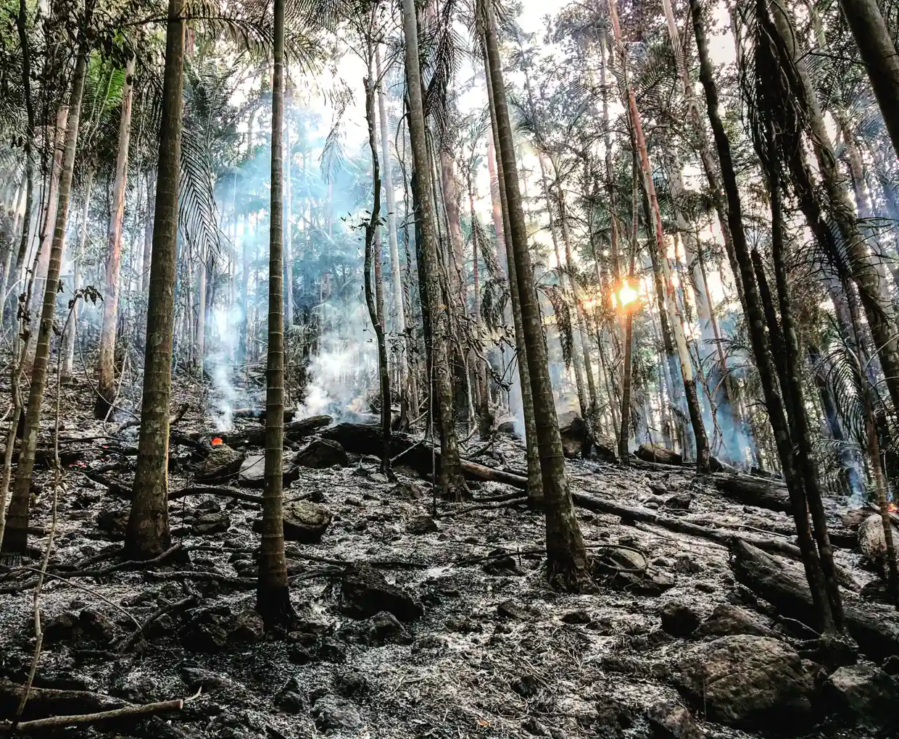
Natural Environment - What is happening now?
3 months
Work to rapidly quantify environmental impacts and inform prioritization of recovery actions
Damaged and changed landscapes have significant impacts on psychological and physical wellbeing, particularly for Indigenous Peoples who are deeply connected to land
Focus on making safe and reopening of priority visitor areas
Identify impacts on places of cultural heritage and community significance.
Talking with local Indigenous communities about cultural heritage sites damaged by disaster, (or new sites that have been uncovered) is an important step in working together to inform priorities in environmental restoration and the ongoing care of the local environment.
3 months
Notes:
Activities with current focus
Identify impacts on places of cultural heritage and community significance
Doing immediate vector control work – also starting to management of weeds and pests
Important need to appropriately balance environmental clean up with minimising further damage to local ecology and habitat
Activities that are future focused
Implement waste management plan – as clean up of environmental debris and green waste is underway and the disposal of tonnes of waste in local facilities is challenging
Work to rapidly quantify environmental impacts
Build evidence base for future recovery efforts (including consideration of conservation and rejuvenation options within and beyond the disaster impacted area)
Develop understanding loss of habitat and species impacts
Identifying impacts on places of cultural heritage and significance
Managing unstable slopes – public and private land and properties

Slide 14
Notes:
ACTION: Group Question: At 3 months - what point do you think we are at now on the recovery journey?
At 3 months communities are likely to be on the red downward slope – frustration, red tape, loss of support, exhaustion
It is normal for all communities, even those with strong social capital to experience periods of conflict and fatigue
Some fragmentation may be occurring within the community around the support available and accessing it – communication is the key

Slide 15
What is happening in the community at 3 months?
The early recovery support for the community is winding down
The majority of volunteers have left, even though there is still much to do
Media attention has moved on, risk that communities may start to feel ‘forgotten’ by the wider world
Payment of grants and appeal funds has begun, ineligibility can cause distress and create community tensions
Decisions around “remain, relocate or return” are being made
Emergence of mental health, drug and alcohol, domestic violence and relationship breakdown issues
Notes:
The early recovery support for the community (e.g., recovery team and out of area relief groups) is winding down.
Contractors to perform recovery and restoration activities will be slowing recovery and increasing stress/anxiety for those impacted.
Donated goods still require places to be stored and there remains risks of competing for community spaces and impacts on local businesses.
Inequities may surface disaster impacts and recovery trajectories tend to reflect existing social inequities and often exacerbate them.
Information about post-trauma support, appeal funds and grants are becoming available.
Local businesses will be reopening or trying to reopen (this challenge can be exacerbated by the presence in the community of donated goods as well as delays in reconnecting utilities).
Transport routes likely to be open (although bridge repairs will take longer).
People beginning to return to work and schools open or relocated (which may mean that families are ‘separating’ for the first time since the disaster).
Usually, the number and identity of fatalities and injuries will be known in the community by this time – depending on the nature of the disaster, memorials and/or funerals may be occurring.

Slide 16
At 3 months the needs of the community can be even greater than when the disaster first hit.
Plan early for an increase in the demand for support and services.

Slide 17
Core Recovery Strategies - 3 weeks to 3 months
Social
Recovery Hubs
Mobile recovery and outreach services
Community recovery information meetings
Community events and activities that support community connection
Variety of hardship/relief assistance
Insurance forums
Coordination of donations
Coordination of volunteer groups (out of area)
Temporary Housing and housing assistance plan and pathways
Recovery Case Management Services, including Indigenous appropriate services
Community Recovery Officers - DRFA
Wellbeing and mental health programs
Environment
Make safe and removal of fallen and dangerous trees (including supporting private landholders)
Exemptions for disaster waste
E.g. - waiving of tip fees for households and businesses
Creative approaches to managing green waste
Wildlife assessments
Make safe activities to reopen priority visitor sites of nature and conservation estates
Assessment and repairs to cultural sites
Prioritise support for Indigenous peoples to remain on Country
Assessment and repairs to walking tracks and trail networks
Notes:
ACTION: Print copies and place on table groups as reference documents
Core Recovery Strategies are a reference document for table group discussions.
They do not provide a comprehensive list of strategies and are not tailored for your specific scenario.
They are intended as a starting point to inform in recovery group discussions to develop strategies that need to be implemented in the first three months following a disaster.
Familiarise the group with these slides and explain their purpose to support group discussion. Do not discuss each point in detail.
Note that the first three months after disaster are extremely busy with the development and implementation of recovery strategies that need to be rolled out as soon as possible with some continuing for months to years.

Slide 18
Recovery Strategies - 3 weeks to 3 months
Built
Emergency repairs/ restoration of essential utilities, electricity, water, gas, sewerage
Emergency repairs/rebuilding of roads and culverts, bridges and other critical infrastructure
Coordinated clean up and clean out assistance
Clean out or replacement of potable water tanks
Farm fencing: practical support for clean-up, removal and repair – facilitation of volunteer agencies
Economic
Strategies to get business back open as soon as possible
Clean up and clean out assistance
Outreach to provide welfare support assistance
Business Impact Surveys: inform grant funding packages
Communication Campaigns
“Buy local” to support businesses
Tourist areas – “Open for business”
Rural financial counselling services
Financial aid and rates relief

Slide 19
3 weeks – 3 months
Considering the community consequences and emerging issues at this stage of recovery:
What are the priority planning actions in response to these issues?
Which organisations/representatives do you need on, or linked to your recovery subcommittee?
Notes:
ACTION: Group Discussion Activity. Allow 15 mins
Refer to next slide as an example of how to record discussion outcomes

Slide 20
Community Need | Recovery Activity | Agencies | Implementation Timeline
Removal of damaged/destroyed houses and debris Available and accessible longer term temporary housing Information and support to assist homeowners navigate planning and rebuilding processes USE A NEW ROW FOR EACH STRATEGY | Coordinated clean up Temporary housing program Rebuilding Advisory Service Support Program For each of your strategies: What needs to be considered in development of this strategy, what resources and expertise will be needed, what are the challenges or constraints. Interdependencies with other recovery groups: Are there elements of this community need and strategy that need the support of other recovery environment/committee groups. | Lead Agency: Supporting Agencies: Local Govt State Agencies NGOs | Start: 2 weeks Duration: 6 months Start: 1- 2 months Duration: at least 2 years Start: 6 months Duration: at least 3 years Consider: When does this strategy/activity need to start to support community recovery? Start: Weeks, months, years How long will the strategy need to run for?
Notes:
ACTION: Discussion Question: What are the priority planning actions in response to these issues?
ACTION: Distribute A3 (double sided) printed copies of the Recovery Considerations Group Discussion template and the Recovery Committee membership template.
ACTION: Guide participants how to record the outcomes of their discussions on the template, using the prepopulated examples on the template to demonstrate.
ACTION: Advise participants that the templates will be used to record and build on the outcomes from each of the 3 Recovery Consideration sessions.
ACTION: Discussion Question: Which organisations/representatives do you need on, or linked to your recovery subcommittee?
ACTION: Instruct participants to record the agencies on the paper provided.
ACTION: Advise participants that reporting back on table discussions will be held over until the whole group plenary after the third session (after Afternoon Tea).
ACTION: Ask participants to highlight 2 priority issues and actions for the 3 week – 3-month timeframe to report back on in the afternoon plenary discussion.

