Slide 1
Fundamentals of Community Recovery
Part A
Notes:
The following slides provide a guided walk through of the Module.
The package takes approximately one hour to run, including the group discussion activity.
The slides can be tailored to your region/local area and include local examples and photos.
The module can be run as one session or broken down into two segments to fit with the design of the exercise day and agenda. You can decide how you want to split the module to fit with the timings of your day by moving the slide titled Part B.
Notes are in standard format. Facilitator actions are in bold italics.
It’s a good idea to print out a 'notes' version of the slide deck for your reference and use on the day.

Slide 2
Disaster Recovery Experience
Notes:
GROUP ACTIVITY
Participants will bring a range of disaster recovery experience to the exercise, with some being introduced to disaster recovery concepts for the first time, while others may have many years of experience. Understanding the breadth of recovery experience in the room is helpful for facilitators and for participants.
The aim of the exercise is to give everyone a sense of the breadth of recovery experience in the room. There is no right or wrong, everyone brings different levels of experience and understanding. This usually reflects the breadth of experience that can be found in members of a recovery committee.
ACTION: As you ask each of the following questions, ask participants to raise their hands.
Participants who have:
More than 10 years of experience working in recovery
5 – 10 years of experience
3 – 5 years of experience
1 – 2 years of experience
No experience

Slide 3
Objectives
Increased understanding of:
Disaster recovery concepts and principles
The impacts of disasters on individuals and communities
The importance of the community’s role and participation in recovery
How local community organisations can support emergency management arrangements

Slide 4
There are many different ways people
can be affected by a disaster and often
people are affected in more than one way.
Notes:
The following slides will take us through the breadth and depth of the impact disasters can have on people’s lives.

Slide 5
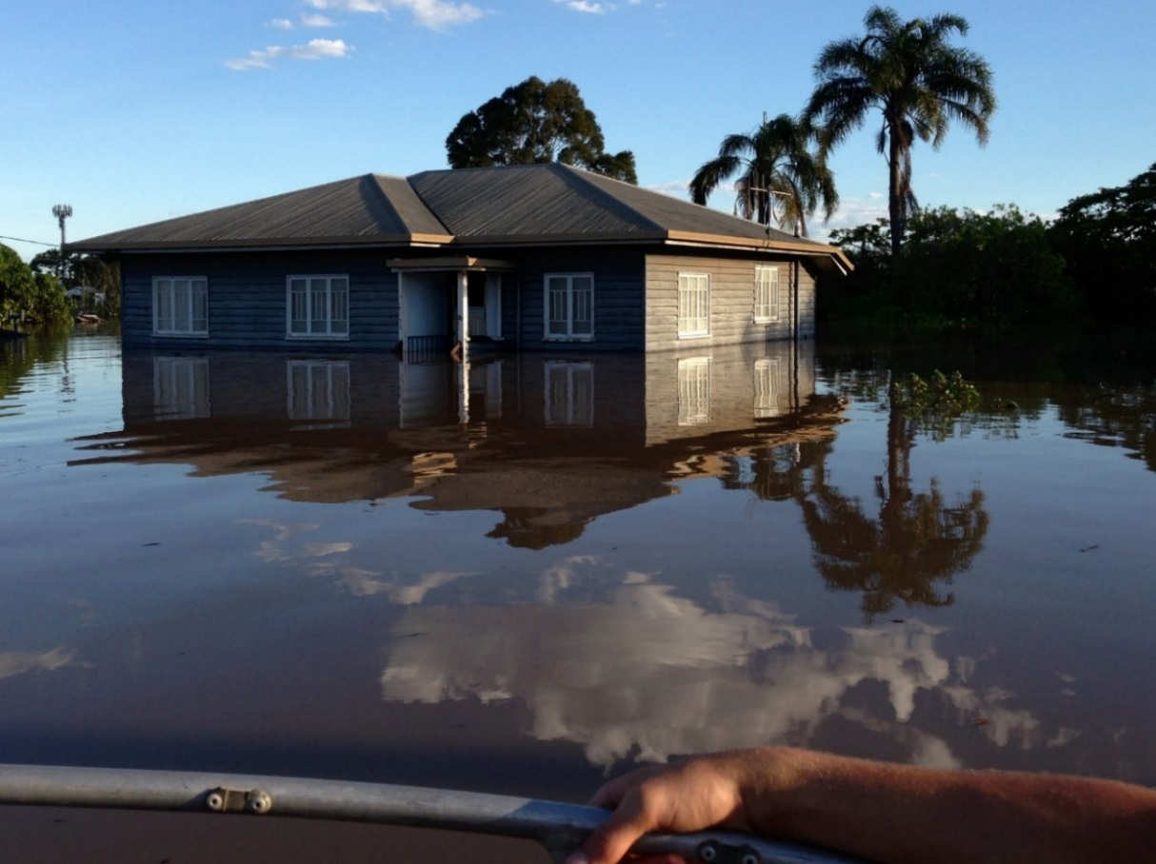
Personal loss
Lost lives or injury to loved ones and pets
Loss or damage to homes/property
Loss of things you value
Loss of jobs and livelihood
Loss of security and safety
Loss of future plans, hopes, aspirations
Grief and loss are a big part of a recovery journey
Image courtesy of Australian Red Cross
Notes:
In disasters people can experience great loss of many things that are important and meaningful to them.
Grief and loss is a big part of disasters and a big part of a recovery journey. Supports to help people navigate grief and loss are important.
When disasters have resulted in loss of life – it brings another overlay of grief and complexity to recovery.

Slide 6
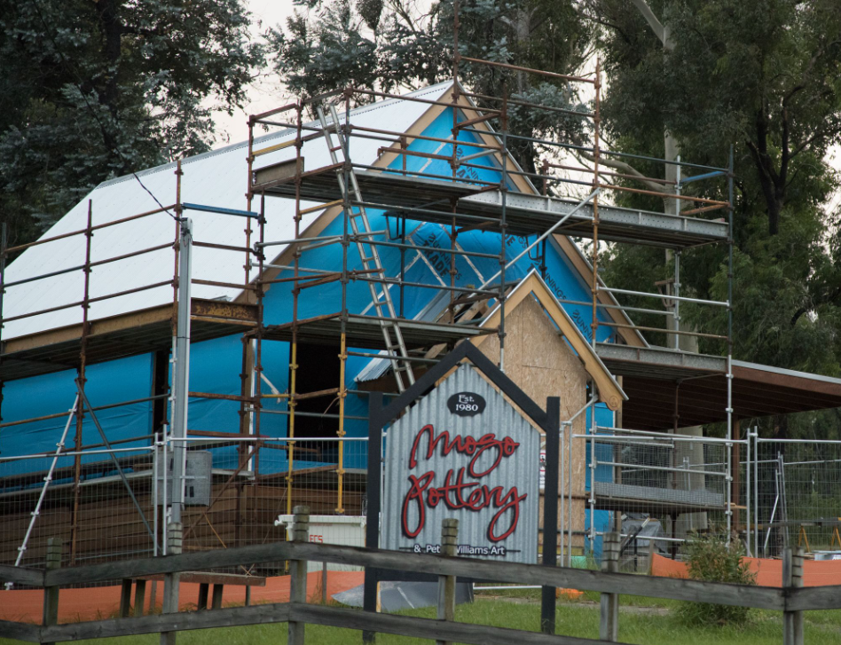
Business, employment and tourism
Physical damage and economic impacts
Loss of livelihoods, employment and income
Indirect impacts, loss of trade and tourism
Re-establishing local business is vital to community functioning and recovery
Notes:
Local businesses are vital to support the functioning of local communities - When businesses are impacted, communities are impacted. The whole economy of a local area is affected – the supply chains, hospitality and tourism.
A community cannot recover until businesses are back up and running
A good measure of early recovery is when when shops are open and people can buy food, essential items and petrol.
Indirect impacts of disasters can be very damaging businesses and tourism:
The flow effects on from business and economic impacts that can occur from disruption to business operations, such as loss of trade or extended electricity outages resulting in loss of stock, can result in continued reduced levels of business, especially in tourism-based businesses.
Sometimes, even though major tourism centres are not directly affected by disaster, compounding factors and public perception of damage can lead to a dramatic reduction in tourist visitors for long periods.

Slide 7
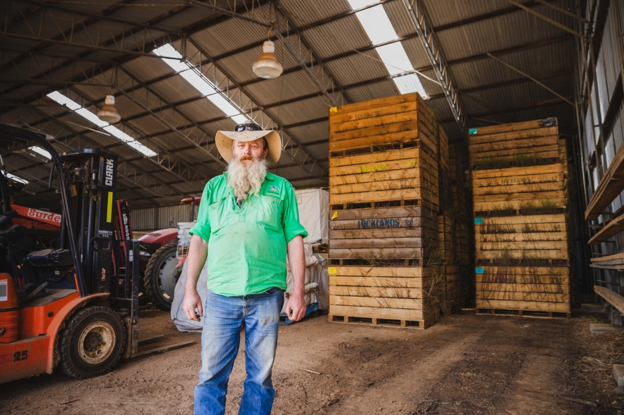
Animals and agriculture
Loss of livestock and feed, crops, farm machinery, fences, access roads, water tanks pumps and irrigation
Economic impacts, short medium and long term
When a disaster hits primary producers, food production and supply is affected. There are consequences for producers and consumers. Recovery strategies need to be mindful of this.
AAP Image: Farmer in front of lost potato crop
Notes:
The dramatic impact and range of loss from disasters on primary producers can be less visible. As well as livestock and crops, there can be extensive damage and loss to fences, and essential business infrastructure such as farm machinery, water tanks and pumps and farm access roads, both private and local.
Agriculture can be impacted in a variety of ways; it is often not simply a process of easily replacing what has been lost. Losses can include generational blood lines of livestock or genetic lines of crops (such as grape vines that are over 100 years old) that once lost can never be replaced. Many crops will take a number of years from when they are reestablished to when they will yield.
When a disaster impacts primary producers food production is affected and supply is affected, with consequences for both the producers and consumers
Damaged road networks can damage crops on way to market – or mean that dairy farms are unable to transport milk.
Recovery strategies need to take this into account.
Compounding effects of disasters:
In recent years, the compounding disasters of drought, fires, floods and the pandemic have affected farmers in all industries across Australia and placed enormous mental and financial strains on primary producers. Almost three years of stress from compounding and overlapping disasters have affected farmers in all industries across Australia.
There is no one size fits all approach – flexible approaches are needed.

Slide 8
Environment and wildlife
Loss or damage to wildlife and the environment
Restore features that reconnect people with their local environment
Image courtesy of Australian Red Cross
Notes:
Prioritise the restoration of local features that enable people to connect to the natural environment (such as walks and parks) and initiate diverse opportunities to enable people to engage with the spiritual and cultural significance of nature in their lives.

Slide 9
Natural and cultural heritage
When disasters damage Country, the harm felt by Indigenous peoples can be particularly profound due to the deep connections between land, culture, history and colonisation.
Recovery approaches should be respectful of the history, culture, strengths and circumstances of affected Indigenous communities, including deep connectedness to the land.
RECAP Guide: Indigenous Peoples and Recovery Capitals Understanding unique experiences
Notes:
“For Aboriginal people, relationships to country, culture and community are not only interconnected, they are intrinsically linked and enmeshed with one’s identity. This means that when one of these foundations is impacted by a disaster, Aboriginal people experience unique pain and loss. BRV also recognises that this harm is compounded by – and cannot be detached from – trauma incurred due to longstanding social dislocation and upheaval as a direct result of past policies of governments at all levels.”
Bushfire Recovery Victoria Recovery Framework, 2021, p18
Do your emergency and recovery plans identify Indigenous cultural heritage sites of significance?
RECAP Guide: Indigenous Peoples and Recovery Capitals - Understanding unique experiences
When disasters damage Country, the harm felt by Indigenous peoples can be particularly profound due to the deep connections between land, culture, history, colonisation and identity. Trauma can also arise from needing to relocate, and losing or being separated from loved ones and community.
This trauma can be worsened by disaster response and recovery services, including through racist encounters and culturally unsafe processes. Mainstream services and grants often fail to account for the particular experiences of Indigenous peoples.
These systemic issues produce vulnerability, and it is the systems that must be fixed. Instead of describing Indigenous people as ‘vulnerable’ in disasters, we need to focus on these systemic problems, and the strengths that Indigenous peoples possess in spite of them.
Recovery approaches should be respectful of the history, culture, strengths and circumstances of affected Indigenous communities, including deep connectedness to the land.
How have Indigenous peoples been impacted by this disaster? Consider residents, distinct communities and legal rights and interest in the land as First Peoples.
How can recovery be enhanced by listening to Indigenous people’s experiences and deep knowledge of resilience, healing and how to live with Country?
Develop and maintain strong working relationships with local Indigenous organisations. Be guided by these organisations and Elders to centre Indigenous peoples’ voices in developing recovery strategies which minimise the risks of exacerbating existing trauma and vulnerability. Strategies should recognise and build on the strength and resilience of Indigenous communities.

Slide 10
“It’s been an eventful couple of weeks, but at the moment we’re stuck emotionally, physically and mentally, we’re just drained.
We don’t know how to move forward right now.’’
Image courtesy of Australian Red Cross
Notes:
People will be affected emotionally, physically and mentally.
Feelings of being ‘stuck’ and unable to make decisions are very common.

Slide 11
Disasters are stressful and people can have a range of responses:​
Shock and disbelief
Feeling paralysed and immobilised
Feeling overwhelmed
Difficulty absorbing, processing and retaining information
Inability to make decisions, even small ones – decision fatigue
Fearful for the future
As a recovery practitioner it is important to take these things into account in the way you interact with disaster affected people and provide information and support
We do know that in the longer term most people recover well, but it can be a long and difficult road.
Notes:
People’s responses to disaster are typically normal responses to an abnormal event. It’s important to remember that reactions to grief and trauma can be confronting.
It’s important that support services are available for people to access when, where and how they need it. This includes support for emotional distress, mental health, family violence, drug and alcohol use and financial counselling.
Disasters are stressful and can have a profound impact on people’s mental health and wellbeing. However, we do know (based on disaster research), that in the longer term most people recover well, but it can be a long and difficult road.

Slide 12
The same disaster can affect different people differently
Everyone has been impacted by a common experience, but we will all experience the disaster differently.
We all bring different challenges, capacities and resources into our experience of being impacted by a disaster.
We are not all the same when we are impacted by disaster therefore our recovery will be different.
There is no one-size-fits-all approach to recovery
Notes:
The same disaster can affect different people in different ways.
No two people will experience the disaster in exactly the same way.
People are different and there will be many variations of experience as well as pre-existing conditions and challenges that will impact how a person will recover
There is no one size fits all approach to recovery or recovery strategies. A range of services and strategies must be provided to cater for the different and emerging needs of people.

Slide 13
Creating culturally safe places for Indigenous peoples in evacuation and recovery centres
Supporting Indigenous peoples in culturally appropriate and culturally centred ways is incredibly important, so that Indigenous peoples can have the same access to safety and services as everyone else.
Creating safe places
Publicly acknowledge the local Traditional Owners of the land the centre is on
Create a separate and safe space for Elders
Have adequate facilities for families with children and babies
Invite the local Indigenous organisations to be present in evacuation and recovery centres
Provide evacuation and recovery centre staff and volunteers with cultural safety training
Notes:
ACTION: Include this slide if you are not running the Working with Indigenous Peoples in Recovery Module as part of your exercise day
These concepts are covered off more comprehensively in the Working with Indigenous Peoples in Recovery Module
Trauma can be worsened by disaster response and recovery services, including through racist encounters and culturally unsafe processes. Mainstream services and grants often fail to account for the particular experiences of Indigenous peoples.
There are some simple ways to make culturally safe spaces that will help Indigenous peoples feel welcome in evacuation and recovery centres.
These considerations should be included in evacuation and recovery centre planning and audits.

Slide 14
Notes:
Information is the lifeblood for communities in recovery
Information that a community needs at in their first week of recovery is different to the information they will need during their sixth week of recovery. Keep it simple and appropriate.
Three questions to ask about your recovery communications:
1. is it relevant?
2. is it clear?
3. is it targeted?
Relevant
People affected by an emergency are often overwhelmed by huge amounts of information. Following an emergency, people want to know:
what is happening with the recovery process
what support is available
what they need to do to qualify for support
what they can do if they have questions, concerns or complaints.
If material does not address one of these four broad categories, ask yourself: does it actually need to be sent? As communication is a two-way process, actually asking affected people what they need will help ensure your communications are relevant!
Clear
After an emergency, people often have trouble remembering or understanding information. It is not appropriate to use jargon, overly complicated or technical language:
short, sharp amounts of relevant and practical information is best
ensure there is a clear call to action in the communication (what does the person actually have to do?)
ensure that there are formats available for people with a sensory impairment, and/or people from culturally and linguistically diverse (CALD) backgrounds.
When using text based communications, ensure the font and size of the text is readable.
Targeted
The method of communication you use should fit the audience:
Just because you can send information or use a certain communication channel doesn’t necessarily mean you should.
For example, if you want to alert women in a small community about a maternal health clinic opening, placing posters in the local bakery may be more effective than updating your website with highly polished content.

Slide 15
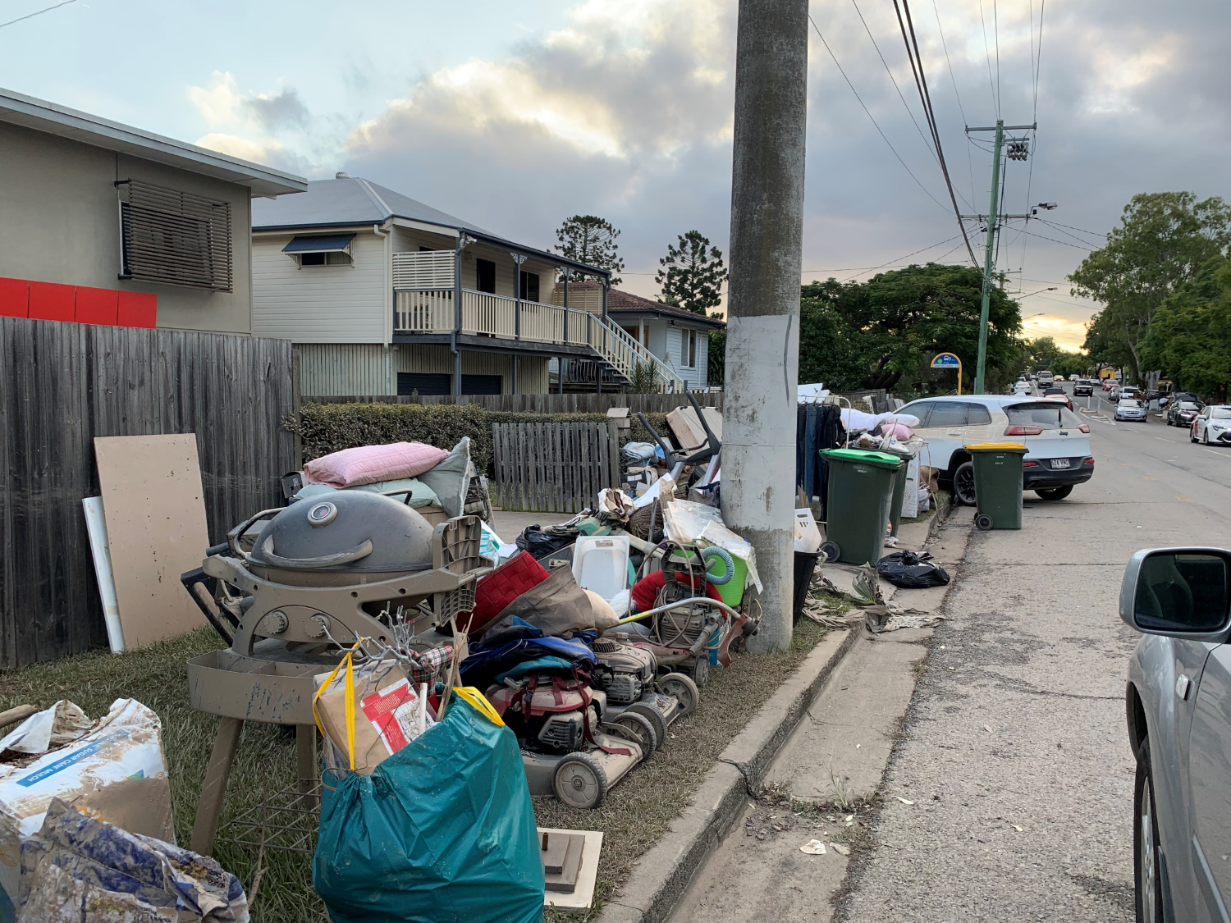
Disasters cause temporary and sometimes permanent damage to community networks
Day to day routines disrupted
People displaced from homes (sometimes permanently)
Services and systems that people rely on are unavailable
Critical and community infrastructure damaged
Image courtesy of Australian Red Cross
Notes:
Disasters affect communities in many ways, including disruption to normal routines, physical harm and social disruption. (Community Recovery, AIDR, Page 5)
Communities are made up of social connections and networks. Social connections and networks increase resilience and promote recovery.
We know that one of the best predictors for how well a community will recover after a disaster, is how connected it is and how connected community members are with each other. This can also be referred to as social cohesion.

Slide 16
Everyone in the community is affected when a disaster hits, even if their home or property was not directly impacted.
Notes:
A disaster happens to the whole community – people may be directly or indirectly affected.
Its important to remember that while everyone is affected – this does not mean that everyone is equally affected as people may be affected in different ways and to different degrees – everyone does not have the same experience.
Recovery strategies need to consider and be inclusive of the whole community and provide varying levels of support and assistance.

Slide 17
The Lived Experience When does recovery start? How long does it take?
Recovery starts at impact and always takes time.
It is long term and complex – it takes years
"Recovery is an ongoing process – there’s no quick fix – and everyone is at a different stage in their personal recovery journey."
A/CEO Anthony McMahon, Bega Valley Shire Council
Notes:
Quotes from people with lived experience - who have had a role in recovery in their communities.
“Recovery is an ongoing process—there’s no quick fix—and everyone is at a different stage in their personal recovery journey.
A/CEO Anthony McMahon, Bega Valley Shire Council: 2 yr anniversary Black Summer Bushfires.
The path to recovery is not linear or smooth, setbacks can be distressing but are part of a normal process and are expected.

Slide 18
Recovery – a plain English definition
Recovery is the process of coming to terms with the impacts of a disaster and managing the disruptions and changes caused, which can result, for some people, in a new way of living.
Being ‘recovered’ is being able to lead a life that individuals and communities value living, even if it is different to the life they were leading before the disaster event.
Community Recovery Handbook (AIDR 2018)
Notes:
There have been many definitions of recovery over the last 20 years. Earlier definitions were characterised by concepts such as ‘returning to normal’, or ‘back to proper levels of functioning’. In more recent years the key theme of recovery definitions is that disasters change the way things were, and the way things will be in the future will be new and different.
The definitions on this slide are from the Community Recovery Handbook (AIDR 2018).
United Nations Office for Disaster Risk Reduction (UNISDR 2017) defines recovery as:
‘Recovery is the restoring or improving of livelihoods and health, as well as economic, physical, social, cultural and environmental assets, systems and activities, of a disaster-affected community or society, aligning with the principles of sustainable development and ‘build back better’, to avoid or reduce future disaster risk.’

Slide 19
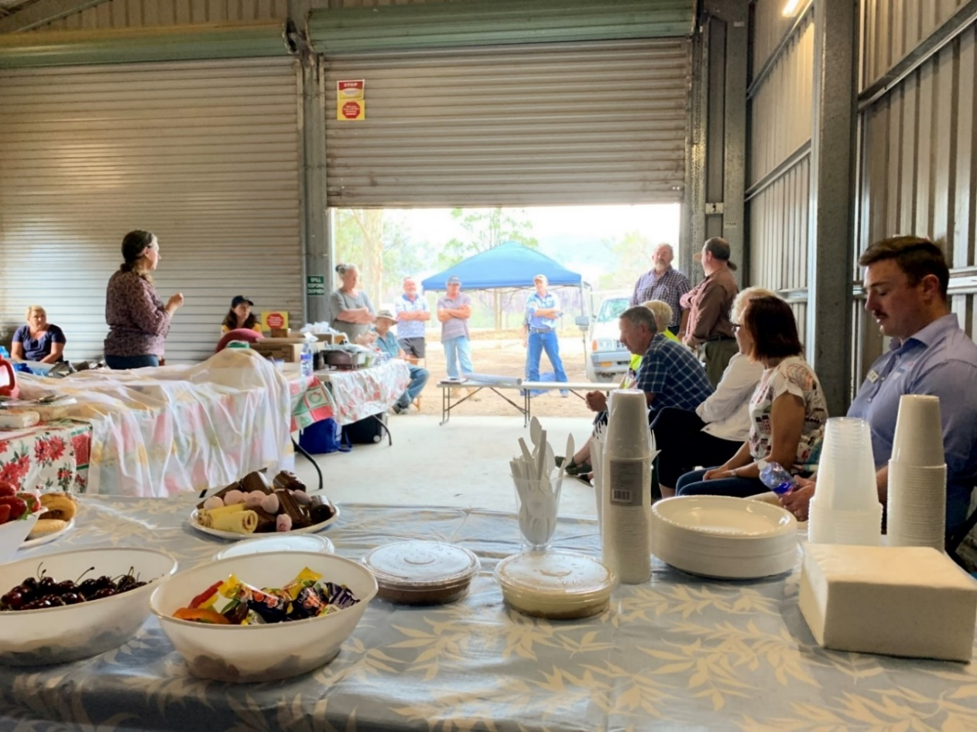
Communities influencing and shaping their own recovery
People in communities will lead their recovery in informal and practical ways.
Recovery is best achieved when affected communities are actively involved.
Image courtesy of Australian Red Cross
Notes:
People in communities will lead their community recovery process in informal and practical ways.
Recovery is best achieved when affected communities are actively involved. (AIDR’s Knowledge-into-Action briefs; Introduction to Recovery).
Recovery governance structures need to be aware of what is happening in the community and connect with, and support community led initiatives so that everyone can work together in a more coordinated way and the assets and contributions of community are recognised and harnessed.
The task for Recovery Committees is to identify and work with recognised community leaders and to support and facilitate community led processes.
Recovery Committees and reference groups need to be able to legitimately represent the needs, issues and views of the broader community.
Processes that are ‘government-supported and community-led’, provide a foundation or framework within which communities can work with government and non-government agencies and other recovery stakeholders.
Australian Disaster Resilience Handbook Collection: Community Recovery Handbook (aidr.org.au).
It is also important to engage with more marginalised groups that may not be represented through more prominate and established community structures.

Slide 20
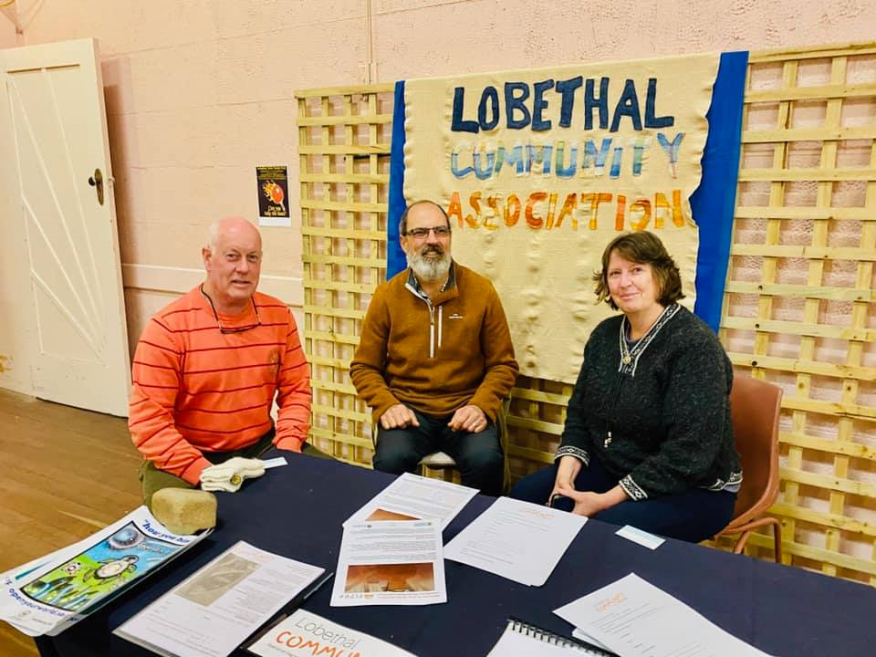
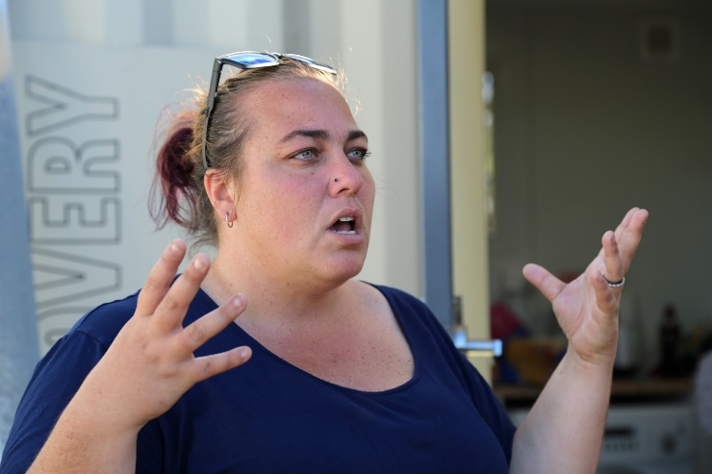
Local leaders and community champions
Community leaders are not necessarily the people with the loudest voices.
They are the people who represent and champion approaches that the majority of the community consider to be appropriate, valid and relevant to them.
Images courtesy of Australian Red Cross
Notes:
A community leader is most likely a respected and trusted individual who is already delivering some form of local support either alone, or as part of a community group.
The task for Recovery Committees is to identify and work with respected and trusted community leaders and to support and facilitate community led processes.
Recovery Committees and reference groups need to be able to legitimately represent the needs, issues and views of the broader community.

Slide 22
Central role of local government
Closest level of government to community
Strong local knowledge and networks
Provide a broad range of services to the community, all of the time, not just after disaster
Will still be supporting the community after other recovery services have concluded.
Notes:
Recovery requires a whole of council involvement. It is not just the person designated as the Recovery Coordinator. Every division in council has a role, community development, economic development, infrastructure, waste and environmental services and the communications team. It is important that all these areas of council are represented on the Recovery Committee.
Supporting communities through recovery can be challenging and resource intensive for councils.
Recovery is more effective when councils take a proactive role and are engaged with their communities through all phases of recovery.
Councils working in partnership with local agencies across all sectors leads to better recovery.

Slide 23
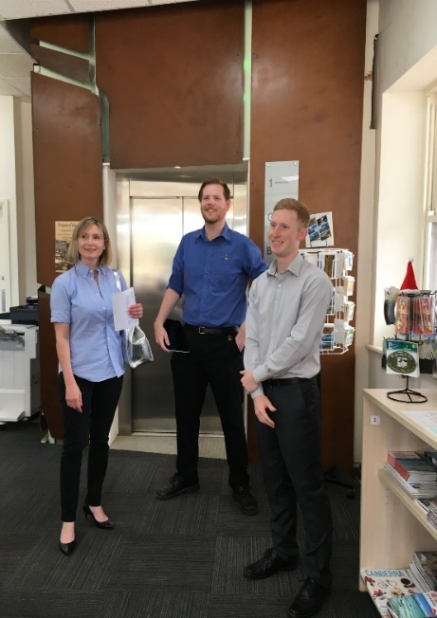
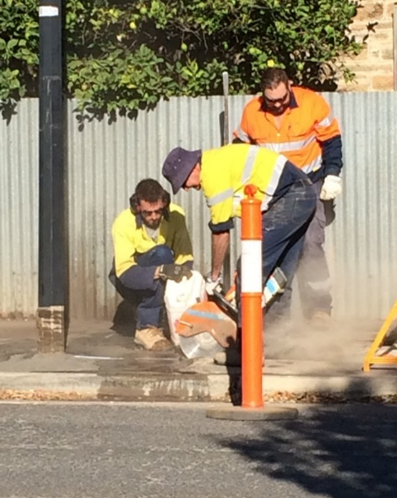
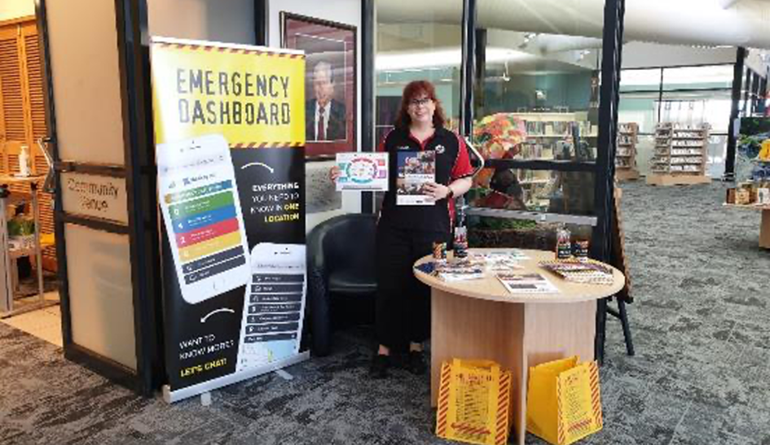
Supporting a community through recovery is complex and challenging
Some council staff may be personally impacted by the disaster
Delivery of everyday essential services must go on alongside recovery activities
All divisions of council are impacted and have recovery responsibilities
Long-term recovery can lead to staff fatigue
Notes:
Supporting communities through recovery can be challenging and resource intensive for councils.
There are often council staff who have had their homes and/or businesses directly impacted by the disaster.
Recovery disrupts business-as-usual in almost every part of councils.
Councils may need to divert resources away from other functions to restoring critical infrastructure and support community recovery.
The long-term nature of recovery can lead to organisational fatigue as staff sustain high workloads over an extended period.
Strategies such as deploying staff from other councils to assist in maintaining business as usual key functions can be an effective way of managing fatigue and combatting burnout.
Making sure that council staff get the time they need for rest and relaxation is important.
Having strategies to support councils that have been impacted by disaster is important. For example:
Sharing learnings, strategies and resources between neighboring councils.
In large scale disasters having staff from councils not directly impacted deployed to carry on with normal business functions while local council staff are working on recovery priorities.

Slide 24
Working with community sector organisations
Local community sector workers:
Live and work in their community
Are known and trusted by their community
Know first-hand the disaster impacts on the vulnerable people that they work with
Have important knowledge, relationships and resources to contribute to the recovery
Will continue to be the main support organisations in the community long after large service providers and government agencies have finished up
Notes:
Local people and community sector organisations have a critical role to play, not just during the immediate aftermath but in the longer-term recovery phase. They live and work within their communities, are trusted, and will still be there after the large service providers and government representatives have left.
Community organisations have a strong track record in activating and mobilising through their local relationships in disaster response and recovery.
Supporting community led approaches to disaster preparedness Summary Research Report: https://frrr.org.au/wp-content/uploads/FRRR-DRFR-Report-Summary-FINAL-for-WEB.pdf.
Community organisations provide a vital conduit between communities and emergency management structures. They know the impacts of natural disasters on the people most at risk, these are the people they support every day. They have important knowledge and resources to contribute in recovery and must be included/linked with formal recovery plans, structures and arrangements.
It’s important to remember that disasters can also impact the capacity of community groups and Recovery Committees should consider what extra support can be provided.

Slide 25
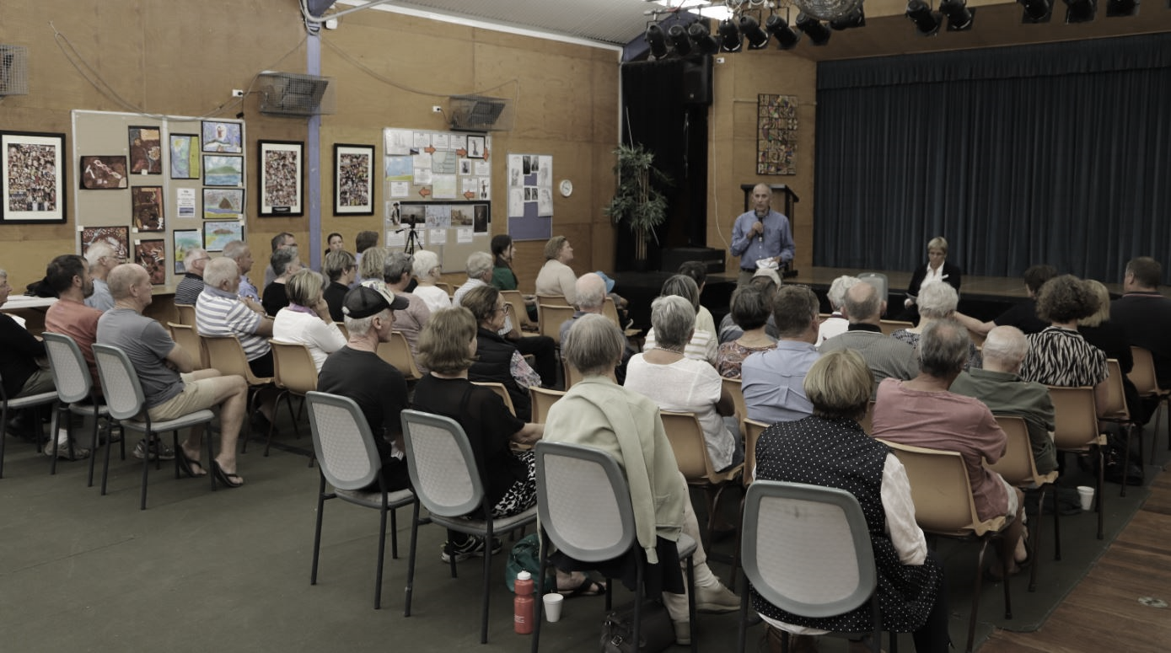
.
“Community organisations are key players in communities and should be recognised as key players in recovery”
“Emergency management and recovery arrangements are not well understood by local communities”
“Greater need for liaison and collaboration between official management structures and community led recovery efforts”
“There is a lack of connection between existing community networks and formal recovery structures”
Notes:
However…
Learnings from past disasters have often highlighted a lack of connection between formal emergency management and recovery structures and community organisations, networks and recovery efforts.
Feedback from communities has identified some consistent themes including:
Emergency management and recovery arrangements are not well understood by local communities
There is a lack of connection between existing community networks and formal recovery structures
Community organisations are key players in communities and should be recognised as key players in recovery
Greater need for liaison and collaboration between official management structures and community led recovery efforts

Slide 26
A partnership approach
Community organisations provide a vital conduit between communities and formal emergency management and recovery structures.
Every organisation and group cannot be on the Recovery Committee.
However…
Recovery Committees must establish linkages with community organisations, groups and networks who can make a valuable contribution in recovery.
Notes:
Community organisations that represent Indigenous peoples, people with disability, domestic and family violence, mental health, children and youth and CALD communities are just some of the types of organisations that need to be linked into emergency management planning and recovery.
Local community consultation groups are a good way to make sure that the community voice is represented on the recovery committee. The Community Recovery Handbook (2018 p.43) provides some guidance about local community consultation groups. Local community consultation/recovery groups are usually established to enable members of the local community to meet and provide input and guidance to the recovery process. Local community consultation groups might comprise:
people affected by the event
representatives from local organisations, and
elected representatives of the community.
How can recovery committees engage with and include community organisations as valuable recovery partners?
ACTION: What existing structures/processes can support the recovery committee to be connected with community organisations?

Slide 27
Notes:
The task for Recovery Committees is to identify and work with legitimate community leaders and champions, to enable community led processes.
Recovery Committees and reference groups need to be able to legitimately represent the needs, issues and views of the broader community.
Community Recovery Committees
Some communities may choose to establish a ‘Community Recovery Committee’.
Community Recovery Committees are led by community elected, respected and trusted community leaders and representatives.
Community Recovery Committees can be a powerful way for the community to have a voice and influence their own recovery.
The best recovery outcomes can be achieved when Government Coordinated Recovery Committees collaborate with and work alongside Community Recovery Committees. The importance of a collaborative approach and the power of organised community can be supported by asking:
What is the community best able to contribute?
What are Government and NGOs best able to contribute?
Where are the opportunities and strengths to collaborate?

Slide 28
Recovery over time
Recovery is long term – it takes years
The needs of individuals and communities will evolve and change over time
Recovery Committee membership will change as community needs evolve
Review membership of the Recovery Committee every six months.
Notes:
A centralised government driven approach to recovery is often necessary in the initial period following a disaster where decisions must be made quickly by those with authority, to mobilise strategies such as clean up and debris removal, waste management, repair of critical infrastructure and temporary housing.
However, these actions need to be undertaken in close consultation with affected communities and informed by emerging needs and priorities. Ultimately the community need to be empowered to develop their own goals and strategies and regain a sense of control.
Representation on recovery committees will change over time as the needs of the community change. It’s a good idea for Recovery Committees to include a review of membership after the first six months in their Terms of Reference.
When a disaster has had a significant impact on a community, a formal recovery committee can run for up to two years and in some cases longer.
Community Recovery Committees (membership of community members) may run for a number of years.

Slide 29
Good practice tips for Recovery Committees
Be as inclusive as possible in identifying and assessing the ‘affected’ community.
Recognise that significant impacts can be experienced by those not considered ‘directly affected’.
Remember that everyone who is affected may not live in the same area.
Plan collaboratively with the community.
Tailor and adapt plans to meet changing community needs.
Identify and work through community leaders.
Community Recovery Handbook (AIDR 2018)
Notes:
The Good Practice Tips above give some helpful suggestions for recovery managers and committees.
From the Community Recovery Handbook (AIDR 2018) Page 6 Community Recovery Handbook (aidr.org.au)

Slide 30
Three perspectives from recovery: Practitioners on community recovery
Notes:
ACTION: You need to be in slide mode to click the open the video linked over the slide
Allow 10 minutes for this video and discussion
Video: 6 mins https://www.youtube.com/watch?v=kQKTBmT3eps
In this video, three disaster recovery practitioners share their perspectives from local and state government and community and talk about the most important things they have learnt from working in recovery.
Leanne Barnes has been a leader working in local and state government for more than 40 years. She was General Manager at Bega Valley Shire Council over the period of the Tathra and Yankees Gap fires in 2018 and the South Coast fires in 2019-20.
Anne Leadbeater lives in Kinglake, Victoria, and was awarded a Medal of the Order of Australia for her work in the aftermath of the 2009 ‘Black Saturday’ bushfires. Anne has 30 years of experience working in the community sector and with state and local government, specialising in disaster recovery and community resilience.
Wendy Graham is a former NSW Government senior executive responsible for community recovery, disaster welfare and community resilience programs. Wendy has provided strategic leadership and recovery coordination in disasters for over 15 years.
ACTION: Whole group discussion: 4 mins
ACTION: Ask the group what messages resonated with them the most?
ACTION: Invite people to call our their response. As each person calls a response invite others to raise their hands if they had the same/similar reflection.

Slide 31
Fundamentals of Community Recovery
Part B
Notes:
Estimated time = 30 minutes

Slide 32
The National Principles for Disaster Recovery
Which principles for disaster recovery are most important to you in your role on the Recovery Committee?
How can these principles influence and inform your practice?
Notes:
ACTION: DISCUSSION ACTIVITY – LEAVE THIS SLIDE ON THE SCREEN
ACTION: Walk through each of the National Principles with the group. The content in this module has demonstrated the importance of these the principles
ACTION: Discuss in Table Groups – 10 mins. Ask:
Which principles for disaster recovery are most important to you in your role on the recovery committee?
How can this influence and inform your practice?
ACTION: Have each group report back on their key learnings and discuss as large group plenary – 10 mins
Each group to share one principle from their discussion.

Slide 33
Take away messages
Recovery is complex and always takes a long time.
Communities will recover more quickly if they are influencing and shaping their own recovery
People will recover at their own pace, everyone’s recovery journey is different
Local people and community sector organisations have an important role to play in recovery
Recovery Committees must stay connected with and be representative of the community

Slide 34
Suggested next steps
Review your emergency and recovery plans – how are local community organisations and the assets they bring referenced?
What are the areas for improvement?
What existing structures/processes (such as interagency meetings or local community consultation groups) can link to the recovery committee so that it can be better connected with community organisations?
Which community organisations can you reach out to for support?
What else do you need to do?

Slide 35
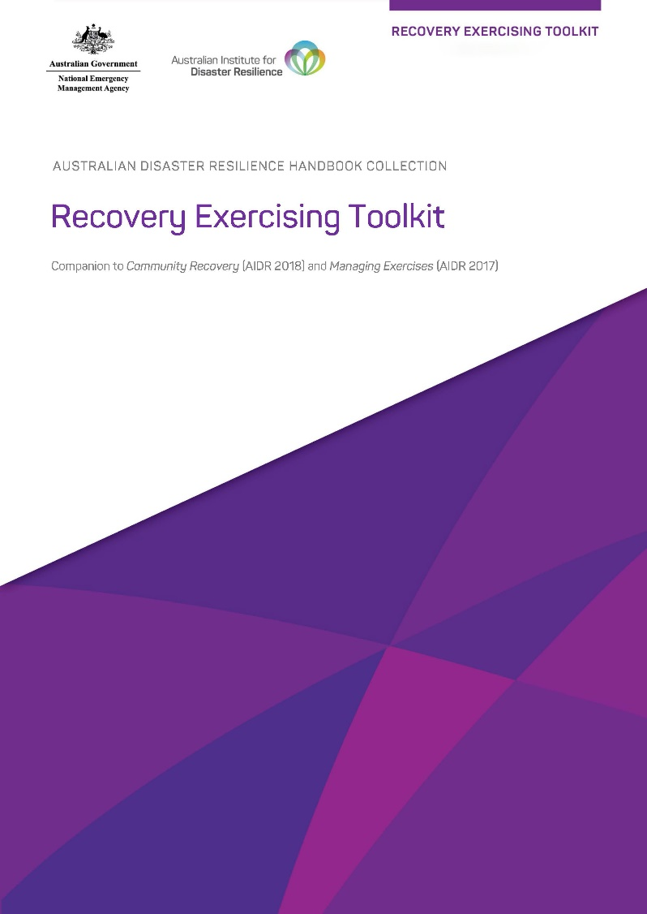
Recovery Exercising Toolkit
The Fundamentals of Community Recovery Module Overview, Slide Deck and other resources are available in the Recovery Exercising Toolkit which can be found on the AIDR Knowledge Hub in the Recovery Collection.
Notes:
The content contained in this module is available in the Recovery Exercising Toolkit: https://knowledge.aidr.org.au/resources/recovery-exercising-toolkit/
ACTION: Encourage participants to access the information through the Toolkit and to explore what else the Toolkit has to offer to help build recovery capability in their committees and agencies.

Slide 36
Where to find out more
Australian Institute for Disaster Resilience, Community Recovery Handbook (2018)
knowledge.aidr.org.au/resources/handbook-community-recovery
Australian Institute for Disaster Resilience, Recovery Matters webinar series
knowledge.aidr.org.au/resources/recovery-matters-webinar-series
Quinn P, Gibbs L, Blake D, Campbell E, Johnston D, Ireton G. Guide to Post-Disaster Recovery Capitals (ReCap) (2021)
www.phoenixaustralia.org/disaster-hub/resources/recovery-capitals
Australian Red Cross, Red Cross Recovery Basics
The impact of disasters on communities and individuals; Working in recovery; Looking after yourself during and after disasters
www.redcross.org.au/emergencies/resources/#recover

