Slide 1
Recovery Considerations
6 to 12 months
Notes:
NOTE TO FACILITATORS
The following slides provide you with a self paced walk through of the session, supported with speakers notes.
Notes are in standard format. Facilitator actions are in bold italics.
You don’t have to use all slides. Link in your local knowledge and examples to make content relevant to participants.
The presentation takes approximately 15 minutes to go through.
The main focus of this session is the group discussion activity – allow 15 mins for discussion.

Slide 2
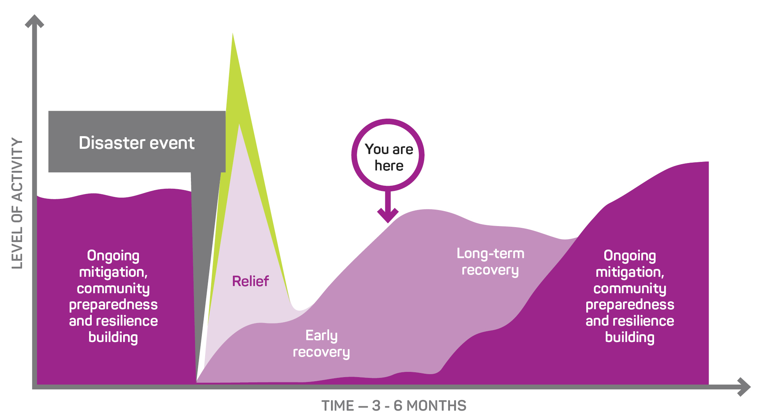
Notes:
The Recovery Journey
The recovery journey follows the disaster event scenario and explores the community consequences and emerging issues that communities will face over time.
At 6-12 months post the disaster event, communities are moving out of early recovery into the medium term recovery phase and still grappling with many of the consequences of the disaster and changes to their lives.
This slide helps participants to see this point of recovery – in between early and longer term recovery and how this phase fits in the broader recovery journey.

Slide 3
6 - 12 months Post Disaster: Recovery Activities
  Recovery Centres/Hubs closing or closed
  Recovery grants, appeals monies and funding packages being delivered
  Clean-up is nearing completion or completed
  Many insurance issues remain unresolved
  Rebuilding is underway
  Findings from post disaster reviews and inquiries are being released
Notes:
Recovery Centres/Hubs have closed or are closing, but the community meetings and consultations will be continuing.
Recovery grants and funding packages are being delivered to those individuals, businesses and producers impacted, but some programs may need to be adjusted to ensure changing needs are being met.
Clean up from the disaster event will be nearing completion.
Restoration and rebuild is underway.
Findings from post disaster reviews and inquiries are starting to be released, (often resulting in the apportioning of blame) with impacts for local response agencies and volunteers.

Slide 4
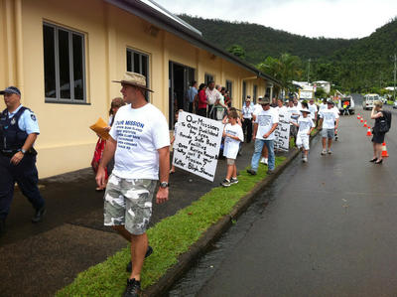
What is happening in the community at 6-12 months?
Challenges and hardships that were accepted at 3 months are now causing frustration and despair: “6 months on and I still don’t have ...”
People are still presenting for help for the first time
Increase in mental health, substance abuse, relationship breakdown and family violence
Emerging trauma responses in children and young people (nightmares, bed-wetting, depression, self-harm)
Community is beginning to think about the upcoming first year anniversary
AAP image
Notes:
The early stoicism of some individuals will be fading with the consequences of the events slowly compounding over time wearing down both emotional and financial reserves. Changing perceptions and expectations, including public confidence in the recovery, which is often at a low point at the 6-month mark. Community tensions may be increasing at this time.
People will still be presenting for help and assistance for the first time.
People may not initially reach out for support and be reluctant to do so for a range of reasons, such as feeling:
that others are worse off than them
they don’t deserve support or financial assistance
they have never accepted financial support before and not familiar with government and other grant processes
they are able to manage on their own without support (practical, personal or financial)
they don’t want to share their personal details and information often required for support to flow.
It is often many months or even years down the track when people have exhausted all their own options and no longer feel they are managing that they will reach out for help. Recovery support services need to be in place over the longer term so that they are available for people when they need them.
Community tensions about the distribution of grant and appeal funds and tensions between community groups in competitive recovery grant applications.
Shortages of trades people and building supplies continue to hamper people’s efforts to repair homes.
Increased and sustained demand has ‘overheated’ the market, making repairs, contractors and materials more expensive than what was budgeted/quoted/insured.
This will have significant impact on many individuals, families and businesses personal and financial stress.

Slide 5
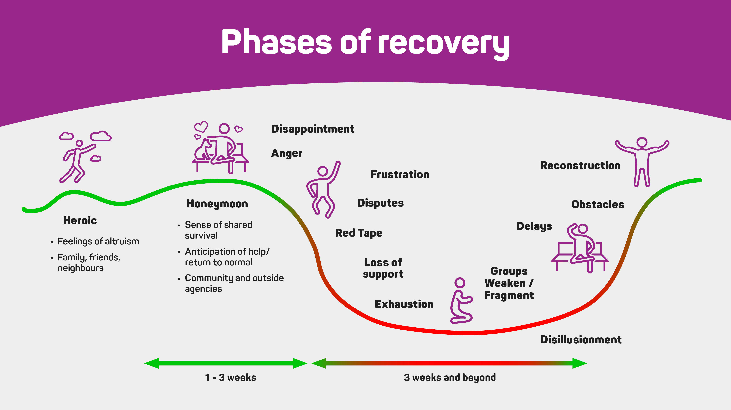
Notes:
ACTION: Group question
At 6 – 12 months - what point do you think we are at now on the recovery journey?
At 6 -12 months the community is likely to have hit the lowest point in the dip and experiencing exhaustion, delays and conflict within the community and also with government and other recovery bodies.
The Myths and Assumptions Table in the Community Recovery Handbook (AIDR, 2018) provides more information about the recovery journey and what you should (and should not do) Pgs 23-24.

Slide 6
Housing - What is happening now?
6 months
  Demand for longer term temporary accommodation remains high as many of homes are still uninhabitable or under repair
Repairs and rebuilding is slow due to:
  Decisions about whether to rebuild or relocate
  Unresolved insurance claims
  Impacts of under insurance and escalating rebuild costs
  Increased and sustained demand has “overheated” the market, making repairs, contractors and materials more expensive than what was budgeted/quoted/insured
  Insurance support for temp accommodation stops at 12 months
12 months
Notes:
Increased and sustained demand has ‘overheated’ the market, making repairs, contractors and materials more expensive than what was budgeted/quoted/insured.
A range of event related consequences continue to impact those most vulnerable, including homelessness.
Exploring accommodation options and planning will now pay off for supporting those still affected.
It is important to update and review plans around 6 months for medium to long term housing arrangements as many people will still be affected by a range of challenges including unresolved insurance claims and insurance support for temporary accommodation ceases at 12 months.
Roads contracts may take long term rentals in the community to ensure available work force placed at detriment of local community.

Slide 7
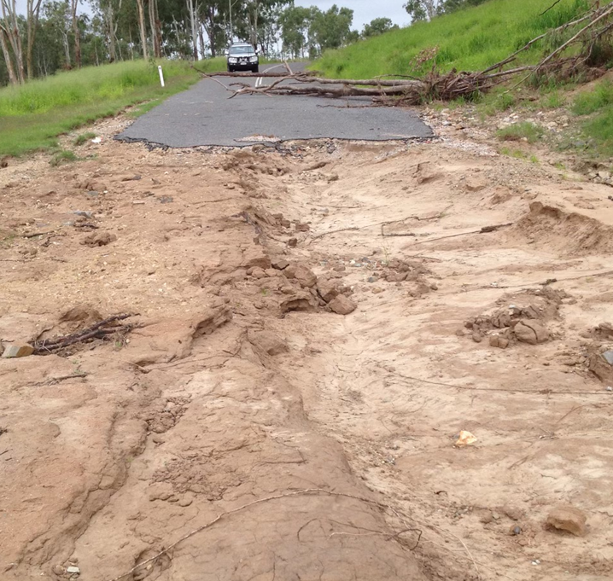
Infrastructure - What is happening now?
6 months
Reconstruction planning and works underway
Betterment discussions ongoing and aligning with scheduled reconstruction
Bridges and other major restoration works occurring
Some hardening of key infrastructure explored or underway
12 months
Notes:
Reconstruction and planning underway – a lot of this work is around procurement of contracts and securing materials and contractors.
Should be exploring opportunities for betterment (build back better) and align opportunities with scheduled reconstruction.
Bridges and other major restoration works occurring.
Some hardening of key infrastructure being explored or underway.
It is also important to note that although works may be underway, they may also be preparing for and trying to mitigate affects from the next high risk weather seasons.

Slide 8
Economic - What is happening now?
6 months
Clean up completed but true economic recovery only just commencing
Challenges for businesses
  Evolves over the short to medium term as the indirect and less tangible consequences from the event unfold, impacting on staff and suppliers
  Some businesses who had been pushing on, may now have exhausted all cash reserves and start to fail
  Scarcity of tradespeople and building supplies and restocking/goods
Challenges for tourism operators
  Tourist areas and tourism infrastructure is damaged or destroyed
  Media coverage discourages tourists from visiting – even when sites are not damaged
  Unavailability of accommodation for tourists discourages visitation
Challenges for primary producers
  Primary producers may still be in sustained distress depending on their business model and crop/produce
  Closed/damaged local roads impeding transport of crops to market
  If crops fail or can’t get to market, food supply and price is affected across Australia
12 months
Notes:
Disaster impacts = debt for businesses - be it small town based or large primary producer.
EXAMPLE: Clean up completed, but it is only at this point (6-12 months) that cash flow begins to re-establish for many types of businesses.
Tourists or visitors may still not return to the area in pre disaster numbers, due to misconceptions about damage to tourist attractions, accommodation and facilities.
What strategies will assist in the economic recovery of the community?
Importantly, this may be an opportune time for businesses to provide services to affected areas, or to renew their businesses/start again with a better business plan.
Recovery committees should be working with local chamber of commerce and business associations working with members to identify the ongoing and often indirect economic impacts.
Loss of crops or stock in primary production can impact cash flow and cash reserves for months or years (sometimes this impact isn’t even realised until months later).
Severe and ongoing financial distress could be experienced for years to come.
Opportunity to work with businesses and support functions such as the Rural Financial Counsellors mentoring.
Intangible impacts may still be manifesting such as:
Loss of confidence (investment and individual decision making)
Loss of future contracts
Loss of, and inability to attract, experienced and skilled staff
Loss of access to transient (backpacker) casual labour

Slide 9
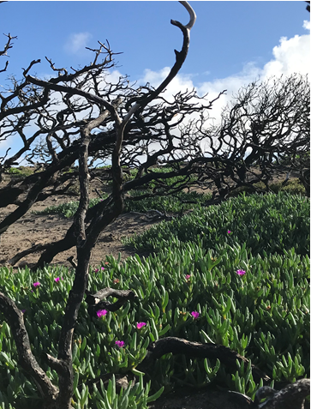
Natural environment - What is happening now?
Moving from clean-up to rejuvenation focused
Evidence base informing funding programs such as:
Erosion control and streambank remediation
Riparian clean up
Targeted recovery and restoration of recreational areas and places of cultural significance
Management of weeds and pests
Programs addressing loss of habitat and species (both fauna and flora) impacts
Image: CSIRO
Notes:
Must be able to respond rapidly to quantify impacts.
Difficult to estimate the exact impact of disaster events.
The impacts of disaster on biodiversity can be severe, so conservation managers must be able to respond rapidly to quantify their impacts, initiate recovery efforts and consider conservation options within and beyond the burned extent.
Good evidence is a must to inform initial recovery efforts and more considered longer term conservation and rejuvenation options within and beyond immediate area. This should include targeted recovery and restoration activities for community and cultural places of significance.
For example, some experts originally predicted the Black Summer Bushfires could have impacted around 800 million in NSW and one billion nationally, with more recent analyses suggesting as many as three billion nationally.

Slide 10
Knowing the next season is coming while still recovering can re-traumatise or be a tipping point for some people.
The thought of further emotional and financial distress can be debilitating.
Expect to see people presenting for a range of supports, including mental support, around 6 months.

Slide 11
Recovery Committees change over time
Communities and individuals' needs and priorities will emerge, evolve and change over time
Strategic approaches to recovery and membership of Recovery Committees also need to change over time
It is a good idea for Recovery Committees to include a review of membership after the first 6 months in their Terms of Reference.
Notes:
Recovery is long term – it takes years.
Communities and individual’s needs and priorities will evolve and change over time.
Strategic approaches to recovery and membership of Recovery Committees also need to change over time as community needs evolve.
A top down, government driven approach to recovery is often necessary in the initial period following a disaster where decisions must be made quickly by those with authority, to mobilise strategies such as clean up and debris removal, waste management, repair of critical infrastructure and temporary housing. However, ultimately the community need to be empowered to develop their own goals and strategies and regain a sense of control.
Representation on recovery committees will change over time as the needs of the community changes. It’s a good idea for Recovery Committees to include in their Terms of Reference a review of membership after the first 6 months.
When a disaster has had a significant impact on a community, a formal recovery committee will usually run for up to 2 years and in some cases longer – Recovery Plans need to reflect this from the beginning.

Slide 12
Recovery Core Strategies 6 – 12 months
Social
Recovery Hubs
Temporary Housing plan and pathways
Wellbeing and mental health programs
Programs for children and young people
Recovery Case Management Services
Supporting connected and cohesive communities
Community Development Officers engaged
Community events and activities Creative Arts Practice Programs
Environment
Stabilize, rehabilitate and restore riverine, wetlands and coastal areas
Removal of fallen and dangerous trees after make safe activities
Soil erosion and prevention
Management of invasive weeds and pests
Weed and feral animal control
Landholder recovery sessions: pasture re-establishment, cropping alternatives, stock disease risk,
Management of stockpiled waste
Notes:
Core Recovery Strategies are a reference document for table group discussions.
They do not provide a comprehensive list of strategies and are not tailored for your specific scenario.
They are intended as a starting point to inform in recovery group discussions.
ACTION: Familiarise the group with these slides and remind them of their purpose to support group discussion. Do not present these slides in detail.
ACTION: Print copies and place on table groups as reference documents.

Slide 13
Recovery Strategies 6 - 12 months
Built
Restoration of community recreational facilities including sports grounds and facilities, parks and conservation estates
Planning provisions to create exemptions for the temporary use and development of land to allow for temporary housing
Monitoring of work sites to ensure licensed work tradespeople attending to repairs and rebuild
Ongoing support for rebuilding
Planning provisions to simplify processes for rebuilding dwellings
Building advisory services for home owners
Economic
Businesses
Business Recovery and Advisory Services
Mentoring, training and development programs
Employment strategies to retain workers in area
Development and marketing of tourism campaigns and events
Tourism education and expansion programs
Primary producers
Working to support sustainability and viability of farm businesses

Slide 14
6-12 months
Considering the community consequences and emerging issues at this stage of recovery:
What are the priority planning actions in response to these issues?
Communications - What does the community need to know now?
Notes:
ACTION: Group Discussion Activity = 15 mins
ACTION: Instruct participants to continue to use their Recovery Considerations Group Discussion template to record the outcomes of their discussions.
ACTION: Record outcomes on the Communications discussion on the butchers paper provided.
ACTION: Remind participants that report back will be held over until the whole group plenary after the third session (after Afternoon Tea). Ask participants to highlight 2 priority issues and actions for the 6-12 month period to report back on in the afternoon plenary discussion.

